Slide 1
Rutgers University
School of Engineering
Fall 2022
332:231 – Digital Logic Design
Sophocles J. Orfanidis
ECE Department orfanidi@rutgers.edu
Unit 7 – Registers, shift registers, counters, LFSRs

Slide 2
Course Topics
1. Introduction to DLD, Verilog HDL, MATLAB/Simulink
2. Number systems
3. Analysis and synthesis of combinational circuits
4. Decoders/encoders, multiplexers/demultiplexers
5. Arithmetic systems, comparators, adders, multipliers
6. Sequential circuits, latches, flip-flops
7. Registers, shift registers, counters, LFSRs
8. Finite state machines, analysis and synthesis
Text: J. F. Wakerly, Digital Design Principles and Practices, 5/e, Pearson, 2018
additional references on Canvas Resources

Slide 3
Sequential circuits (Wakerly, Chapters 9, 10 ,11)
Topics discussed are:
Registers
Shift registers
Counters
Binary counters
Counter design with D and T flip-flops
Counters of arbitrary sequences
Counter initialization
BCD counters
Counters for task control (e.g., traffic light control)
Ring and Johnson counters
Linear feedback shift registers (LFSR)

Slide 4
Contents:
1. Registers
2. Shift registers
3. Counters
4. Binary counters
5. Counter design with D and T flip-flops
6. Counters for task control (e.g., traffic light control)
7. Counters of arbitrary sequences
7. Counter initialization
8. BCD counters
9. Ring and Johnson counters
10. Linear feedback shift registers (LFSR)

Slide 5
References
J. F. Wakerly, Digital Design Principles and Practices, 5/e,
Pearson, 2018.
S. Brown and Z. Vranesic, Fundamentals of Digital Logic with
Verilog Design, 3/e, McGraw-Hill, 2014.
D. M. Harris and S. L. Harris, Digital Design and Computer
Architecture, 2/e, Elsevier, 2013.
M. Mano, C. R. Kime, and T. Martin, Logic and Computer Design
Fundamentals, 5/e, Pearson, 2016.
A. F. Kana, Digital Logic Design, [on Canvas].
E. O. Hwang, Digital Logic and Microprocessor Design
with Interfacing, 2/e, Cengage, 2018.
C. Maxfield, Bebop to the Boolean Boogie, 2/e, Newnes, 2009.
Wikipedia articles on Ring and Johnson counters and LFSRs.

Slide 6
registers
an n-bit register consists of n flip-flops, each independently storing one bit of information
example: 3-bit register holding the bits Q₁, Q₂, Q₃
D₁
Q₁
D₂
Q₂
D₃
Q₃
D
Q
D
Q
D
Q
>
Qʹ
>
Qʹ
>
Qʹ
clock
typically, all flip-flops are synchronously driven by the same clock, and additional external inputs and/or interconnections can be used to load and/or sequence the register contents.

Slide 7
shift registers
serial-in / serial-out
Q₁
Q₂
Q₃
serial input D
D
Q
D
Q
D
Q
serial output
>
Qʹ
>
Qʹ
>
Qʹ
clock
example
t D(t) Q₁(t) Q₂(t) Q₃(t)
0 1 0 0 0
1 0 1 0 0
2 1 0 1 0
3 1 1 0 1
4 1 1 1 0
5 0 1 1 1
6 0 0 1 1
7 0 0 0 1
8 0 0 0 0
Q₁(t) = D(t-1), at clock edges
Q₂(t) = Q₁(t-1) = D(t-2)
Q₃(t) = Q₂(t-1) = D(t-3)
clock
ticks
shift registers act as delay elements
Q(t+1) = D(t), at clock edges
Q(t) = D(t-1), at clock edges

Slide 8
shift registers
serial-in / serial-out
Q₁
Q₂
Q₃
serial input D
D
Q
D
Q
D
Q
serial output
>
Qʹ
>
Qʹ
>
Qʹ
clock
example
t D(t) Q₁(t) Q₂(t) Q₃(t)
0 1 0 0 0
1 0 1 0 0
2 1 0 1 0
3 1 1 0 1
4 1 1 1 0
5 0 1 1 1
6 0 0 1 1
7 0 0 0 1
8 0 0 0 0
Q₁(t) = D(t-1), at clock edges
Q₂(t) = Q₁(t-1) = D(t-2)
Q₃(t) = Q₂(t-1) = D(t-3)
clock
ticks
shift registers act as delay elements
Q(t+1) = D(t), at clock edges
Q(t) = D(t-1), at clock edges

Slide 9
state contents at successive (rising-edge) clock ticks
t D(t) Q₁(t) Q₂(t) Q₃(t)
0 - 0 0 0
initial values
at time t = 0−
FF-1
FF-2
FF-3
D
Q₁
Q₂
Q₃
D
Q
D
Q
D
Q
>
>
>
clock

Slide 10
state contents at successive (rising-edge) clock ticks
t D(t) Q₁(t) Q₂(t) Q₃(t)
0 1 0 0 0
1 - 1 0 0
t=0
D is read and transferred to Q₁
Q₁ is transferred to Q₂
Q₂ is transferred to Q3
and wait until next clock tick at t=1
FF-1
FF-2
FF-3
D
Q₁
Q₂
Q₃
D
Q
D
Q
D
Q
>
>
>
clock

Slide 11
state contents at successive (rising-edge) clock ticks
t D(t) Q₁(t) Q₂(t) Q₃(t)
0 1 0 0 0
1 0 1 0 0
2 - 0 1 0
t=1
D is read and transferred to Q₁
Q₁ is transferred to Q₂
Q₂ is transferred to Q3
and wait until next clock tick at t=2
FF-1
FF-2
FF-3
D
Q₁
Q₂
Q₃
D
Q
D
Q
D
Q
>
>
>
clock

Slide 12
state contents at successive (rising-edge) clock ticks
t D(t) Q₁(t) Q₂(t) Q₃(t)
0 1 0 0 0
1 0 1 0 0
2 1 0 1 0
3 - 1 0 1
FF-1
FF-2
FF-3
D
Q₁
Q₂
Q₃
D
Q
D
Q
D
Q
>
>
>
clock

Slide 13
state contents at successive (rising-edge) clock ticks
t D(t) Q₁(t) Q₂(t) Q₃(t)
0 1 0 0 0
1 0 1 0 0
2 1 0 1 0
3 1 1 0 1
4 - 1 1 0
FF-1
FF-2
FF-3
D
Q₁
Q₂
Q₃
D
Q
D
Q
D
Q
>
>
>
clock

Slide 14
state contents at successive (rising-edge) clock ticks
t D(t) Q₁(t) Q₂(t) Q₃(t)
0 1 0 0 0
1 0 1 0 0
2 1 0 1 0
3 1 1 0 1
4 1 1 1 0
5 - 1 1 1
FF-1
FF-2
FF-3
D
Q₁
Q₂
Q₃
D
Q
D
Q
D
Q
>
>
>
clock

Slide 15
state contents at successive (rising-edge) clock ticks
t D(t) Q₁(t) Q₂(t) Q₃(t)
0 1 0 0 0
1 0 1 0 0
2 1 0 1 0
3 1 1 0 1
4 1 1 1 0
5 0 1 1 1
6 - 0 1 1
FF-1
FF-2
FF-3
D
Q₁
Q₂
Q₃
D
Q
D
Q
D
Q
>
>
>
clock

Slide 16
state contents at successive (rising-edge) clock ticks
t D(t) Q₁(t) Q₂(t) Q₃(t)
0 1 0 0 0
1 0 1 0 0
2 1 0 1 0
3 1 1 0 1
4 1 1 1 0
5 0 1 1 1
6 0 0 1 1
7 - 0 0 1
FF-1
FF-2
FF-3
D
Q₁
Q₂
Q₃
D
Q
D
Q
D
Q
>
>
>
clock

Slide 17
state contents at successive (rising-edge) clock ticks
t D(t) Q₁(t) Q₂(t) Q₃(t)
0 1 0 0 0
1 0 1 0 0
2 1 0 1 0
3 1 1 0 1
4 1 1 1 0
5 0 1 1 1
6 0 0 1 1
7 0 0 0 1
8 - 0 0 0
FF-1
FF-2
FF-3
D
Q₁
Q₂
Q₃
D
Q
D
Q
D
Q
>
>
>
clock

Slide 18
state contents at successive (rising-edge) clock ticks
t D(t) Q₁(t) Q₂(t) Q₃(t)
0 1 0 0 0
1 0 1 0 0
2 1 0 1 0
3 1 1 0 1
4 1 1 1 0
5 0 1 1 1
6 0 0 1 1
7 0 0 0 1
8 0 0 0 0
FF-1
FF-2
FF-3
D
Q₁
Q₂
Q₃
D
Q
D
Q
D
Q
>
>
>
clock

Slide 19
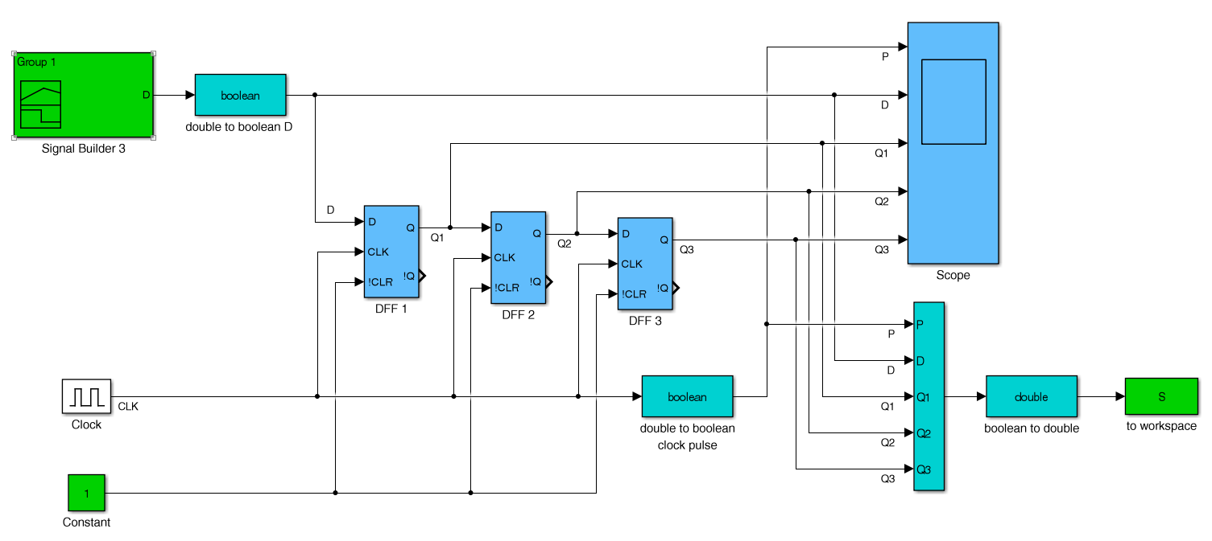
shift registers
serial-in / serial-out
Simulink example: shifting the sequence 1 0 1 1 1 0 0 . . .
file: shift3.slx

Slide 20
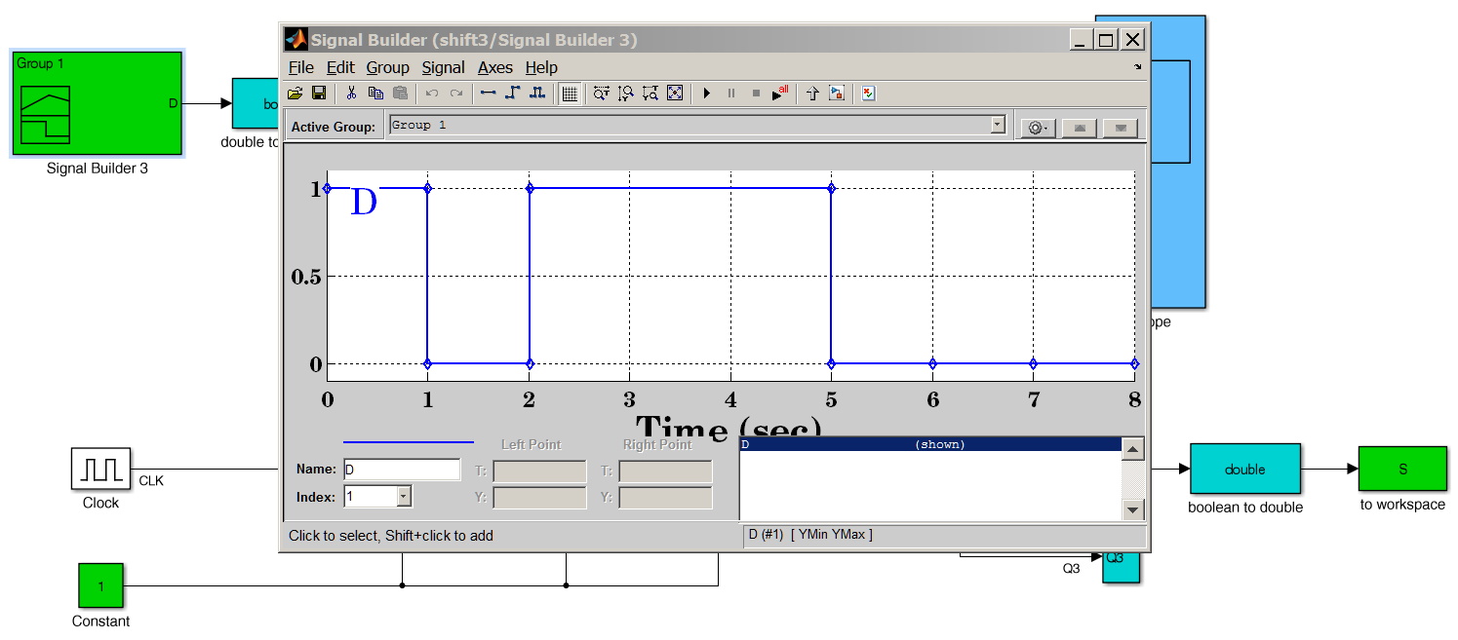
shift registers
serial-in / serial-out
generate input sequence 1 0 1 1 1 0 0 . . .

Slide 21
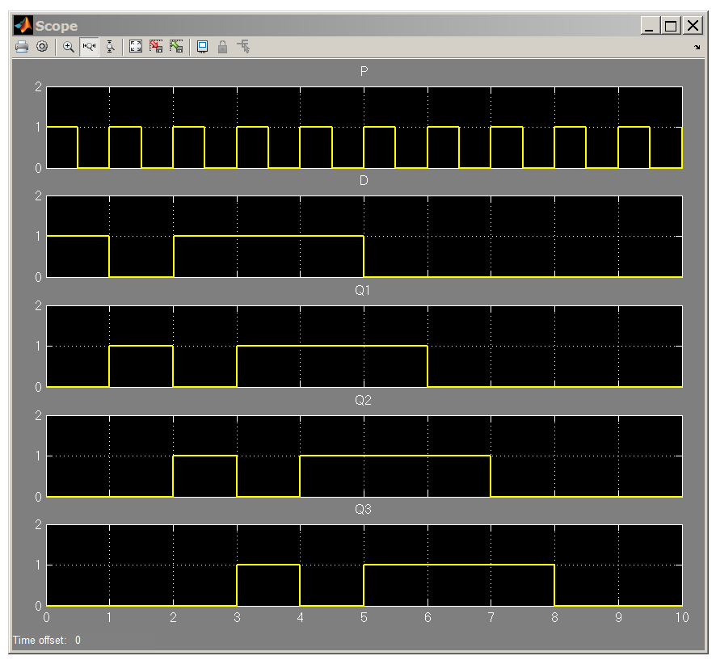
shift registers
serial-in / serial-out
scope
output
1 0 1 1 1
1 0 1 1 1
1 0 1 1 1
1 0 1 1 1

Slide 22
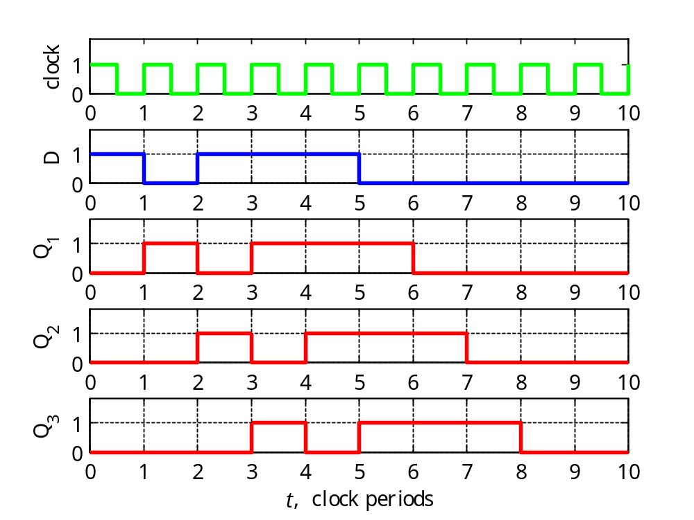
shift registers
serial-in / serial-out

Slide 23
shift registers
serial-in / serial-out
% read Simulink data from timeseries structure S
t = S.time; % time
P = S.data(:,1); % clock pulse
D = S.data(:,2); % overall input
Q1 = S.data(:,3); % flip-flop outputs
Q2 = S.data(:,4);
Q3 = S.data(:,5);
set(0,'DefaultAxesFontSize',10);
figure;
subplot(5,1,1); stairs(t,P,'g-'); ylabel('clock')
subplot(5,1,2); stairs(t,D,'b-'); ylabel('D');
subplot(5,1,3); stairs(t,Q1,'r-'); ylabel('Q_1'); subplot(5,1,4); stairs(t,Q2,'r-'); ylabel('Q_2');
subplot(5,1,5); stairs(t,Q3,'r-'); ylabel('Q_3'); xlabel('{\itt}, clock periods')

Slide 24
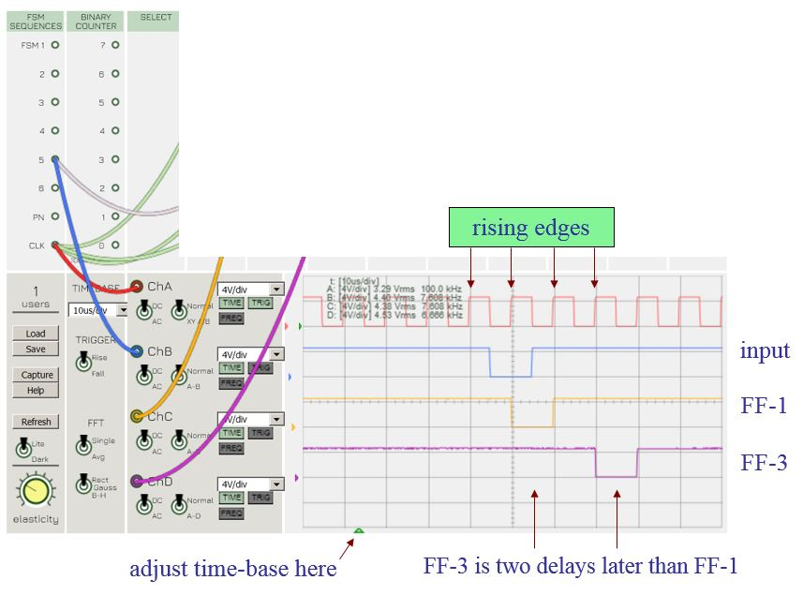
shift registers
Emona board – Lab 6
FF-1
FF-2
FF-3
Q1
Q2
Q3
D
Q
D
Q
D
Q
>
>
>

Slide 25
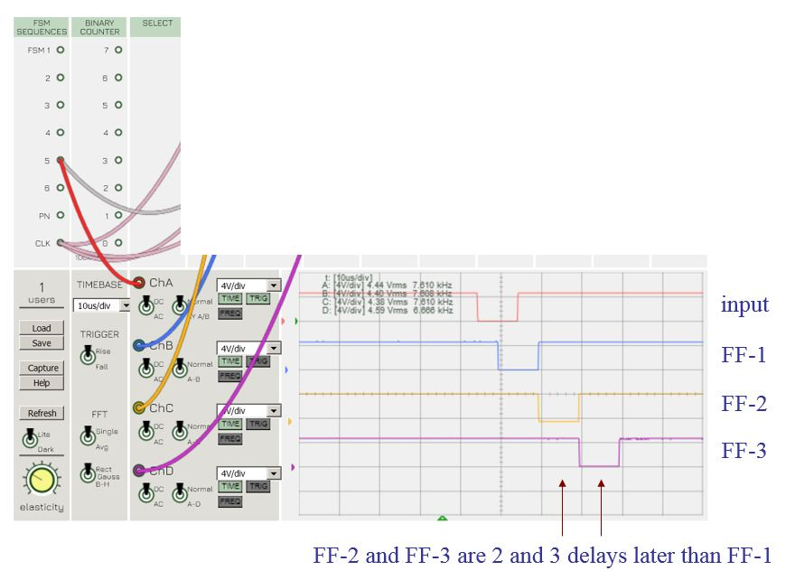
shift registers
Emona board – Lab 6
FF-1
FF-2
FF-3
Q1
Q2
Q3
D
Q
D
Q
D
Q
>
>
>

Slide 26

shift registers
serial-to-parallel converter
serial-in / parallel-in / parallel-out / serial-out
parallel output
Q₁
Q₂
Q₃
shift / load
2-to-1
multiplexer
serial
input
D
0
1
Q
D
0
1
Q
D
0
1
Q
D
Qʹ
serial
output
>
Qʹ
>
Qʹ
>
clock
I₁
I₂
I₃
initial contents

Slide 27
shift registers
serial-to-parallel converter
serial-in / parallel-in / parallel-out / serial-out
with initial contents
zero initial contents
t D(t) Q₁(t) Q₂(t) Q₃(t)
0 D₀ I₁ I₂ I₃
1 D₁ D₀ I₁ I₂
2 D₂ D₁ D₀ I₁
3 D₃ D₂ D₁ D₀
4 D₄ D₃ D₂ D₁
5 D₅ D₄ D3 D₂
6 D₆ D₅ D₄ D₃
7 D₇ D₆ D₅ D₄
8 D₈ D₇ D₆ D₅
. . .
t D(t) Q₁(t) Q₂(t) Q₃(t)
0 D₀ 0 0 0
1 D₁ D₀ 0 0
2 D₂ D₁ D₀ 0
3 D₃ D₂ D₁ D₀
4 D₄ D₃ D₂ D₁
5 D₅ D₄ D3 D₂
6 D₆ D₅ D₄ D₃
7 D₇ D₆ D₅ D₄
8 D₈ D₇ D₆ D₅
. . .
clock
ticks

Slide 28
counters
counters have many uses in DLD:
- generating time intervals for application control
(e.g., for traffic light control)
- counting events
- measuring elapsed time between events
there are many types of counters:
- binary counters
- gray-code counters
- BCD counters
- counting in arbitrary order (see also, lab-6)
- generating arbitrary sequences
- ring counters
- Johnson counters
and specialized ones, such as linear feedback shift registers (LFSR) for generating random-like sequences used in error control coding and cryptography applications, in the testing of digital circuits, and in secure wireless communications, spread spectrum and frequency hopping (see Hedy Lamarr & George Antheil’s frequency hopping patents, and Prof. Soljanin’s PBS podcast on Hedy Lamarr, on ECE)

Slide 29
counters
Synchronous counters are specialized types of finite state machines which are sequentially clocked to generate a desired periodic sequence of numbers.
With n flip-flops, one can generate up to 2^{n} sequence values (states), which can be labeled either according to their decimal values or in ta coded binary form.
design procedure:
Specify the state transition table for the desired sequence, i.e., how the values are to be sequenced in time.
Convert the state table into a state-assigned table (i.e., assigning state variables) using a binary representation of each number in the sequence.
Use K-maps to simplify the next-state functions, Q → Q^{next}, for each bit.
The individual bits Q become the digital states and are stored in flip-flops. If D-flip-flops are used, the inputs to the flip-flops are trivial because, D = Q^{next}. If T or JK flip-flops are used, their inputs T or J,K are also straightforward (see p. 49).

Slide 30
counters
For example, in order to generate the length-8 sequence of numbers, [s₀, s₁, s₂, s₃, s₄, s₅, s₆, s₇], we may list in a table how these numbers (states) are sequenced from one clock time instant to the next.
state transition table
next
t s_{t} s_{t+1}
0 s₀ s₁
1 s₁ s₂
2 s₂ s₃
3 s₃ s₄
4 s₄ s₅
5 s₅ s₆
6 s₆ s₇
7 s₇ s₀
8 s₀ s₁
_{etc.}
clock
ticks
state diagrams are a graphical
representation of state tables
reset/repeat

Slide 31
counters
state diagrams (to be discussed further in unit-8) are directed graphs that convey the same information as state tables, but in a graphical form, where the states are listed inside the circles and the arrows indicate the state transitions taking place at successive clock-edge time instants.
state table
state diagram
next
t s_{t} s_{t+1}
0 s₀ s₁
1 s₁ s₂
2 s₂ s₃
3 s₃ s₄
4 s₄ s₅
5 s₅ s₆
6 s₆ s₇
7 s₇ s₀
8 s₀ s₁
_{etc.}
reset
clock ticks
s₀
s₁
s₂
s₃
clock ticks
s₇
s₆
s₅
s₄
the number of states is finite, hence, the name
“finite state machines”. More general state diagrams can have more complicated transitions between states, including additional inputs/outputs (see unit-8)
repeat

Slide 32
Conventions for drawing state diagrams:
Along each arrow connecting two successive states S and S^{next}, indicate the values of the inputs X that caused this transition from the current state S.
For Mealy machines, indicate along the same arrow the values of the outputs Y that resulted from the values of X and the current state S.
For Moore machines, because the outputs Y depend only on the current state Q, indicate the values of Y inside the circle for the current state S.
clock tick
X / Y
clock tick
X
S
Y
S^{next}
Y^{next}
S
S^{next}
Mealy

Slide 33
counters
once the state table for the desired sequence is specified, one must make state assignments, that is, representing each number in the sequence in binary, e.g., 3 bits in the present example. These bits serve as the states and are stored in flip-flops.
state table
state-assigned table or characteristic table
t s_{t} s_{t+1}
0 s₀ s₁
1 s₁ s₂
2 s₂ s₃
3 s₃ s₄
4 s₄ s₅
5 s₅ s₆
6 s₆ s₇
7 s₇ s₀
8 s₀ s₁
_{etc.}
t Q₂ Q₁ Q₀ Q₂^{next} Q₁^{next} Q₀^{next}
0 . . . . . .
1 . . . . . .
2
3
4
5
6
7
8 . . . . . .
etc. etc.
for D-flip-flops, these become the flip-flop inputs, i.e.,
D₂ = Q₂^{next}
D₁ = Q₁^{next}
D₀ = Q₀^{next}

Slide 34
counters
In general, for a length-N counter, one needs, n = ceiling(log₂N),
state variables, each to be stored in a separate flip-flop. Each of the N numbers in the counter is encoded with n state variables, and represented as an n-bit binary number (state assignment).
Example: N=6, n = ceiling(log₂(6)) = ceiling(2.5850) = 3
state table
characteristic table
t s_{t} s_{t+1}
0 s₀ s₁
1 s₁ s₂
2 s₂ s₃
3 s₃ s₄
4 s₄ s₅
5 s₅ s₀
6 s₀ s₁
7 s₁ s₂
8 s₂ s₃
_{etc.}
t Q₂ Q₁ Q₀ Q₂^{next} Q₁^{next} Q₀^{next}
0 . . . . . .
1 . . . . . .
2 . . . . . .
3 . . . . . .
4 . . . . . .
5 . . . . . .
6 . . . . . .
7 . . . . . .
8 . . . . . .
etc. etc.
repeat
N=6 example

Slide 35
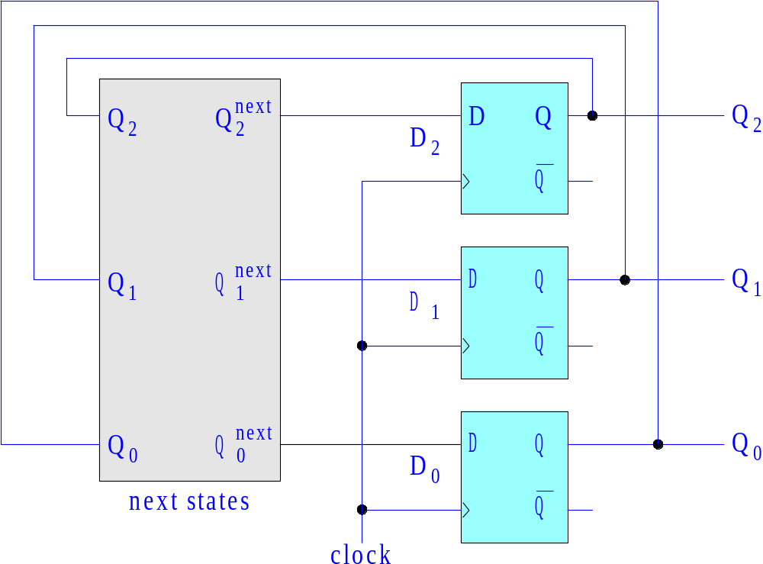
counters
3-bit counter
depends on the
counting sequence

Slide 36
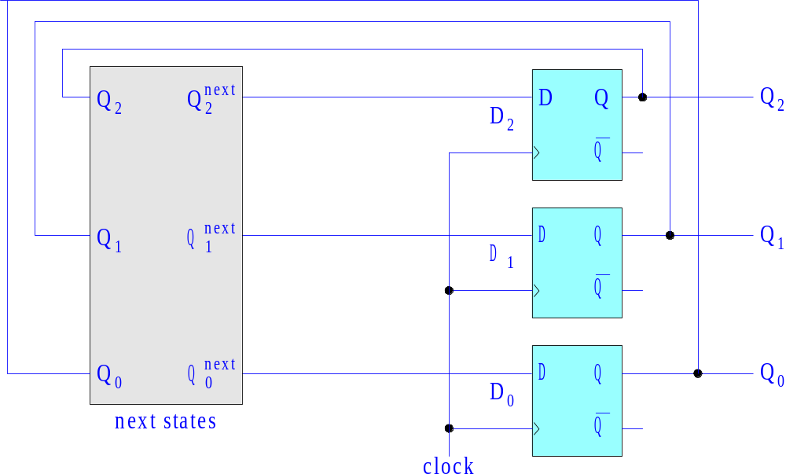
counters
3-bit counter with initial loading
L
1
0
1
0
1
0
I₂
I₁
I₀
L=0, load
L=1, count
load initial values
with 2-to-1 multiplexers

Slide 37
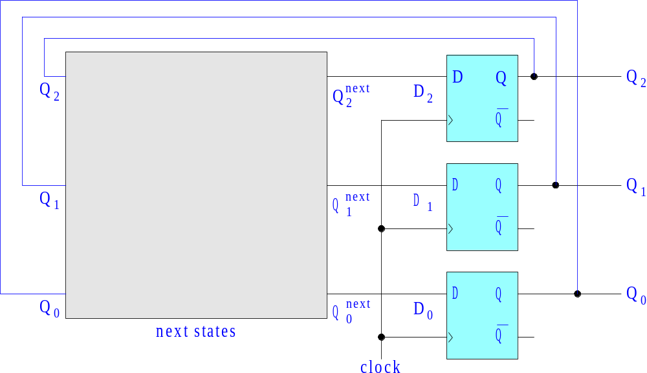
Example 1 – three-bit binary counter. Derive and implement with logic gates the next-state logic for an ordinary 3-bit binary counter, with a periodically repeating length-8 sequence, [ 0, 1, 2, 3, 4, 5, 6, 7 ].
Q₂^{next} = Q₂ ⊕ (Q₁ Q₀)
Q₁^{next} = Q₁ ⊕ Q₀
Q₀^{next} = Q₀ ⊕ 1 = Q₀ʹ
Example 1

Slide 38
characteristic table
s_{t} s_{t+1} Q₂ Q₁ Q₀ Q₂^{next} Q₁^{next} Q₀^{next}
0 1 0 0 0 0 0 1
1 2 0 0 1 0 1 0
2 3 0 1 0 0 1 1
3 4 0 1 1 1 0 0
4 5 1 0 0 1 0 1
5 6 1 0 1 1 1 0
6 7 1 1 0 1 1 1
7 0 1 1 1 0 0 0
start by listing the binary representation of the given sequence and the next states
repeat
then, use K-maps to derive the next-state logic functions,
Q → Q^{next}
recalling the property: a ⊕ b = a bʹ + aʹ b
Example 1

Slide 39
characteristic table
Q₂Q₁
s_{t} Q₂ Q₁ Q₀ Q₂^{next} Q₁^{next} Q₀^{next}
0 0 0 0 0 0 1
1 0 0 1 0 1 0
2 0 1 0 0 1 1
3 0 1 1 1 0 0
4 1 0 0 1 0 1
5 1 0 1 1 1 0
6 1 1 0 1 1 1
7 1 1 1 0 0 0
Q₀
00
01
11
10
0
1
1
1
1
1
Q₀^{next} = Q₀ʹ = Q₀ ⊕ 1
Q₂Q₁
Q₀
00
01
11
10
Q₂Q₁
Q₀
00
01
11
10
0
1
1
0
1
1
1
1
1
1
1
1
Q₂^{next} = Q₂ Q₀ʹ + Q₂ Q₁ʹ + Q₂ʹ Q₁ Q₀
= Q₂ (Q₀ʹ + Q₁ʹ) + Q₂ʹ (Q₁ Q₀)
= Q₂ ⊕ (Q₁ Q₀)
a ⊕ b = a bʹ + aʹ b
Q₁^{next} = Q₁ Q₀ʹ + Q₁ʹ Q₀ = Q₁ ⊕ Q₀
Example 1

Slide 40
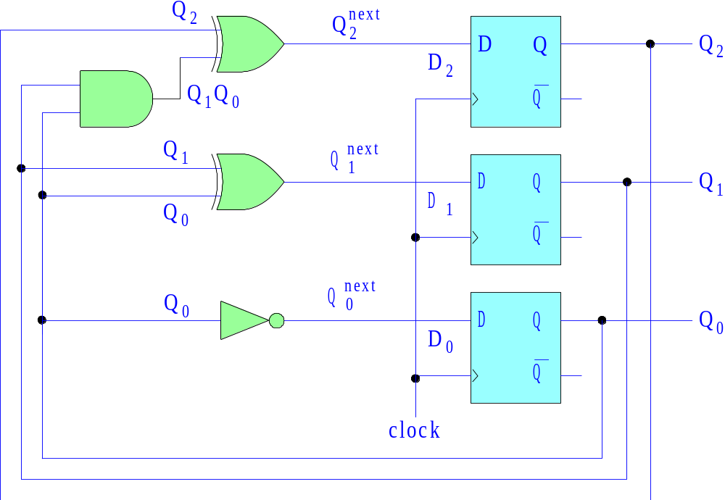
next states
3-bit binary counter
Q₂^{next} = Q₂ ⊕ (Q₁ Q₀)
Q₁^{next} = Q₁ ⊕ Q₀
Q₀^{next} = Q₀ ⊕ 1 = Q₀ʹ
Example 1

Slide 41
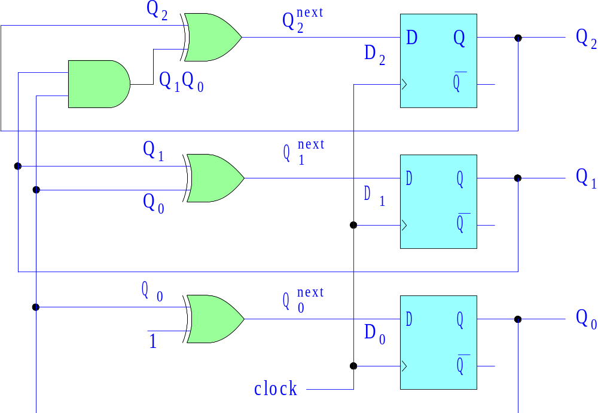
next states
3-bit binary counter
Q₂^{next} = Q₂ ⊕ (Q₁ Q₀)
Q₁^{next} = Q₁ ⊕ Q₀
Q₀^{next} = Q₀ ⊕ 1 = Q₀ʹ
Example 1

Slide 42
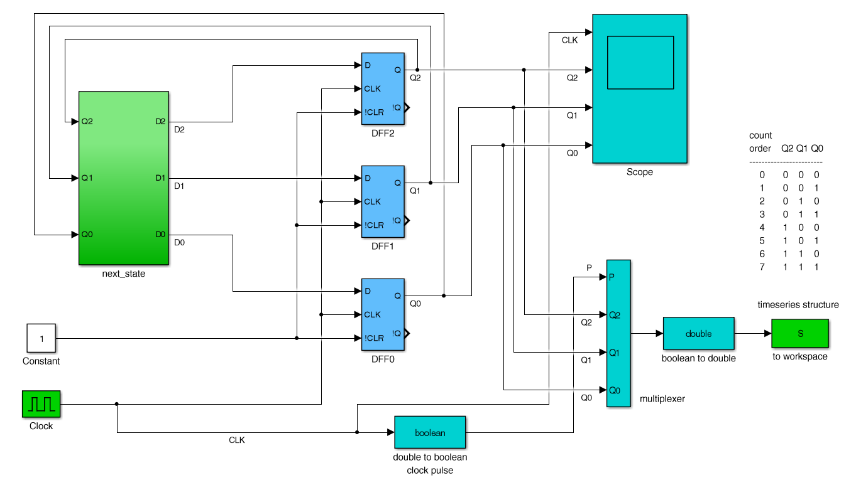
3-bit binary counter
Q₂^{next} = Q₂ ⊕ (Q₁ Q₀)
Q₁^{next} = Q₁ ⊕ Q₀
Q₀^{next} = Q₀ ⊕ 1 = Q₀ʹ
file: count1a.slx
export data to MATLAB workspace
clock period = 1
Example 1

Slide 43
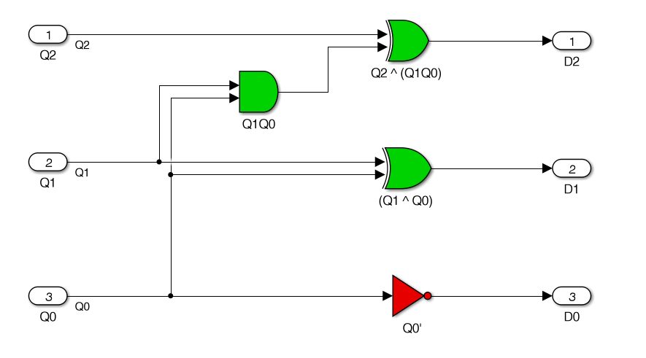
Q₂^{next} = Q₂ ⊕ (Q₁ Q₀)
Q₁^{next} = Q₁ ⊕ Q₀
Q₀^{next} = Q₀ ⊕ 1 = Q₀ʹ
3-bit binary counter
next-state sub-function
Example 1

Slide 44
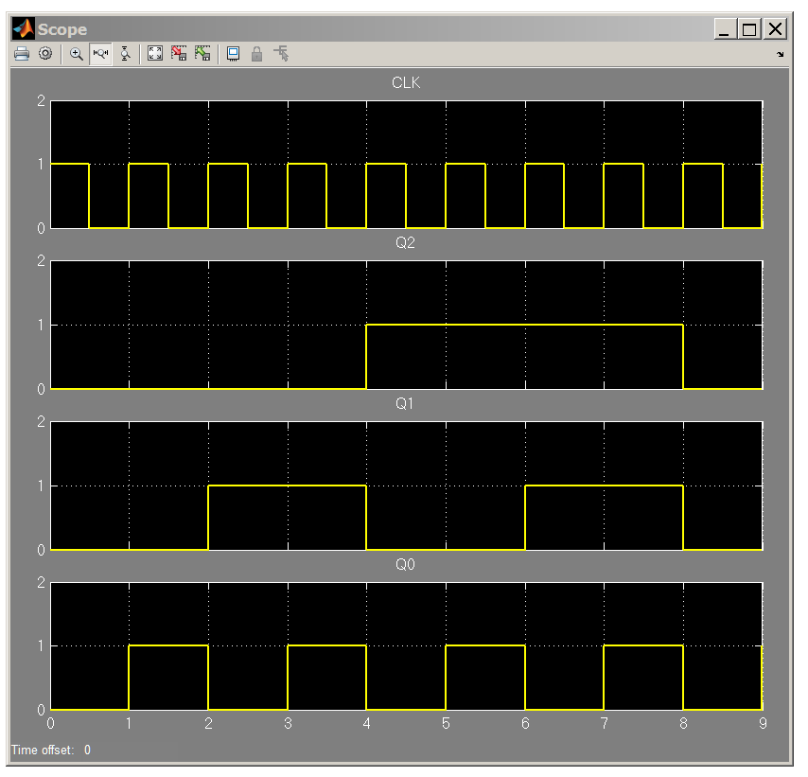
scope display
3-bit binary counter
0 1 2 3 4 5 6 7 0
repeat
Example 1

Slide 45
3-bit binary counter
file: count1abc.m
% plot timing diagram from exported Simulink data
t = S.time; % time
P = S.data(:,1); % clock pulse
Q2 = S.data(:,2);
Q1 = S.data(:,3);
Q0 = S.data(:,4);
set(0,'DefaultAxesFontSize',15);
figure;
subplot(4,1,1); stairs(t,P,'g-'); ylabel('clock')
subplot(4,1,2); stairs(t,Q2,'b-'); ylabel('Q_2');
subplot(4,1,3); stairs(t,Q1,'r-'); ylabel('Q_1');
subplot(4,1,4); stairs(t,Q0,'m-'); ylabel('Q_0');
xlabel('{\itt}')
Example 1

Slide 46
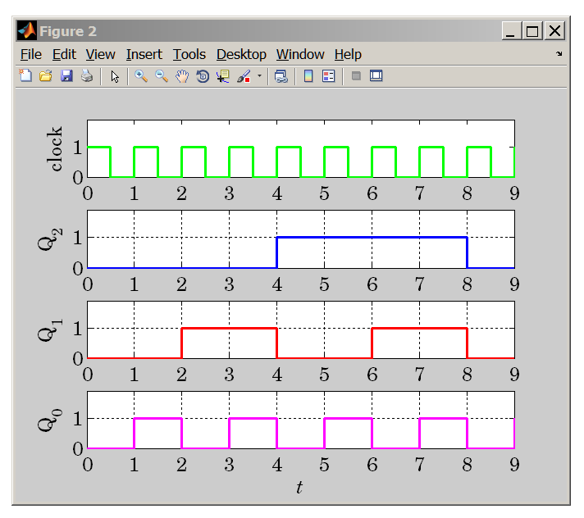
3-bit binary counter
repeat
Example 1

Slide 47
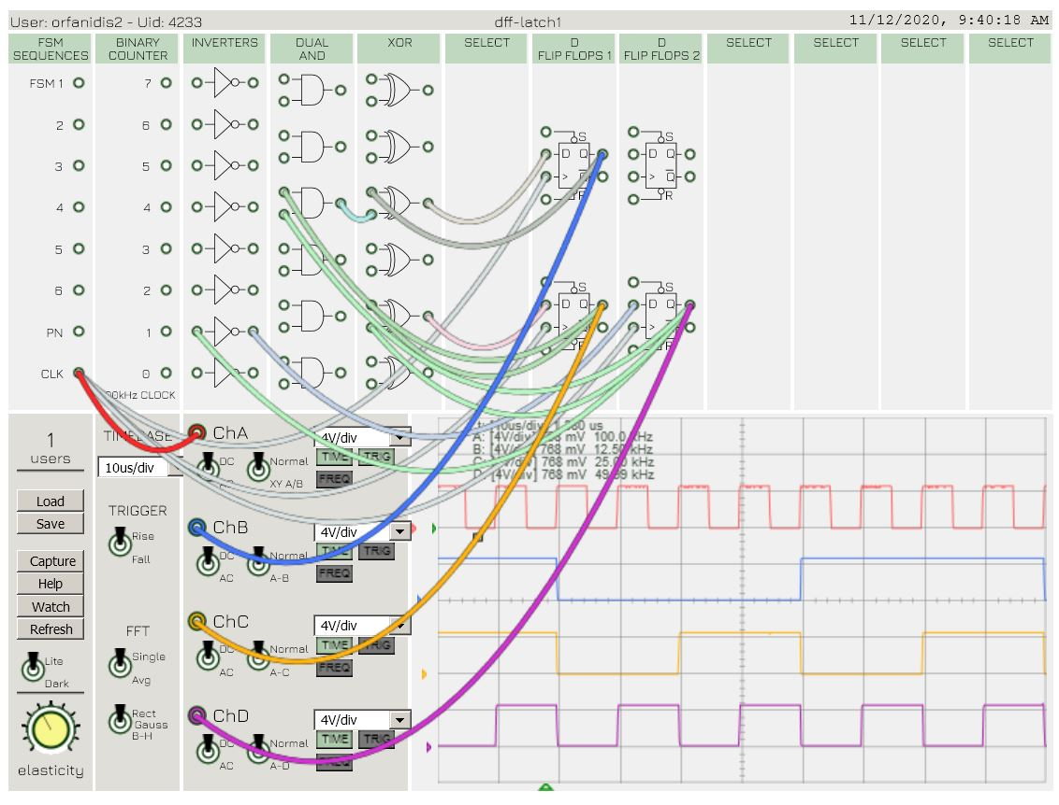
3-bit binary counter
Q₂^{next} = Q₂ ⊕ (Q₁ Q₀)
Q₁^{next} = Q₁ ⊕ Q₀
Q₀^{next} = Q₀ ⊕ 1 = Q₀ʹ
0 1 2 3 4 5 6 7
Example 1

Slide 48
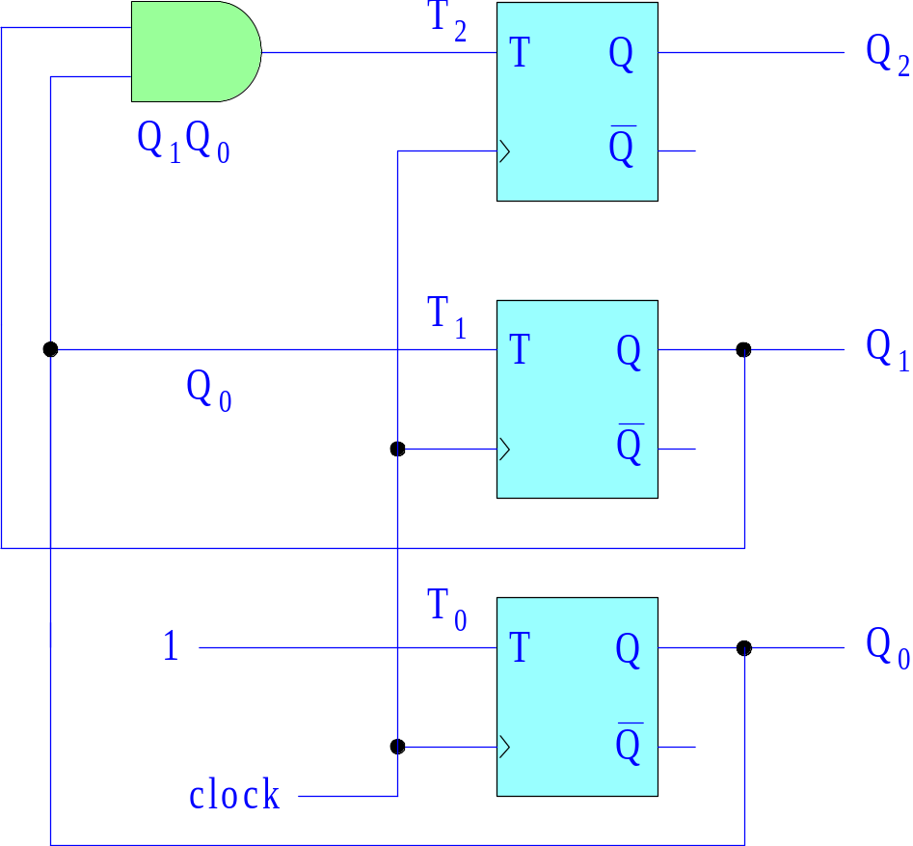
3-bit binary counter
using T-flip-flops
characteristic equation
of T-flip-flop
Q^{next} = Q ⊕ T
Q₂^{next} = Q₂ ⊕ (Q₁ Q₀) = Q₂ ⊕ T₂
Q₁^{next} = Q₁ ⊕ Q₀ = Q₁ ⊕ T₁
Q₀^{next} = Q₀ ⊕ 1 = Q₀ʹ = Q₀ ⊕ T₀
T₂ = Q₁ Q₀
T₁ = Q₀
T₀ = 1
Example 1

Slide 49
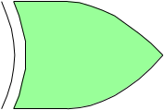

A general procedure for using T or JK flip-flops instead of D flip-flops is to carry out the design using D flip-flops, then, replace each D flip-flop by a T or a JK flip-flop as shown below (effectively converting them to D flip-flops, see unit-6)
T
Q
Q
T = D ⊕ Q
Q_{next} = T ⊕ Q = D
D
clock
>
Qʹ
Qʹ
D flip-flops
D
J
Q
Q
J = D
K = Dʹ
Q_{next} = J Qʹ + Kʹ Q = D
>
K
Qʹ
Qʹ
clock

Slide 50
Example 2 – four-bit binary counter. Derive and implement with logic gates the next-state logic equations,
for an ordinary 4-bit binary counter, with a periodically repeating length-8 sequence, [ 0, 1, 2, 3, 4, 5, 6, 7, 8, 9, 10, 11, 12, 13, 14, 15 ].
Q₃^{next} = Q₃ ⊕ (Q₂ Q₁ Q₀)
Q₂^{next} = Q₂ ⊕ (Q₁ Q₀)
Q₁^{next} = Q₁ ⊕ Q₀
Q₀^{next} = Q₀ ⊕ 1 = Q₀ʹ
using D flip-flops
D₃ = Q₃^{next}
D₂ = Q₂^{next}
D₁ = Q₁^{next}
D₀ = Q₀^{next}
using T flip-flops
T₃ = Q₂ Q₁ Q₀
T₂ = Q₁ Q₀
T₁ = Q₀
T₀ = 1
Example 2

Slide 51
4-bit binary counter
characteristic table
next states
s_{t} Q₃ Q₂ Q₁ Q₀ Q₃ Q₂ Q₁ Q₀ s_{t+1}
0 0 0 0 0 0 0 0 1 1
1 0 0 0 1 0 0 1 0 2
2 0 0 1 0 0 0 1 1 3
3 0 0 1 1 0 1 0 0 4
4 0 1 0 0 0 1 0 1 5
5 0 1 0 1 0 1 1 0 6
6 0 1 1 0 0 1 1 1 7
7 0 1 1 1 1 0 0 0 8
8 1 0 0 0 1 0 0 1 9
9 1 0 0 1 1 0 1 0 10
10 1 0 1 0 1 0 1 1 11
11 1 0 1 1 1 1 0 0 12
12 1 1 0 0 1 1 0 1 13
13 1 1 0 1 1 1 1 0 14
14 1 1 1 0 1 1 1 1 15
15 1 1 1 1 0 0 0 0 0
Example 2

Slide 52
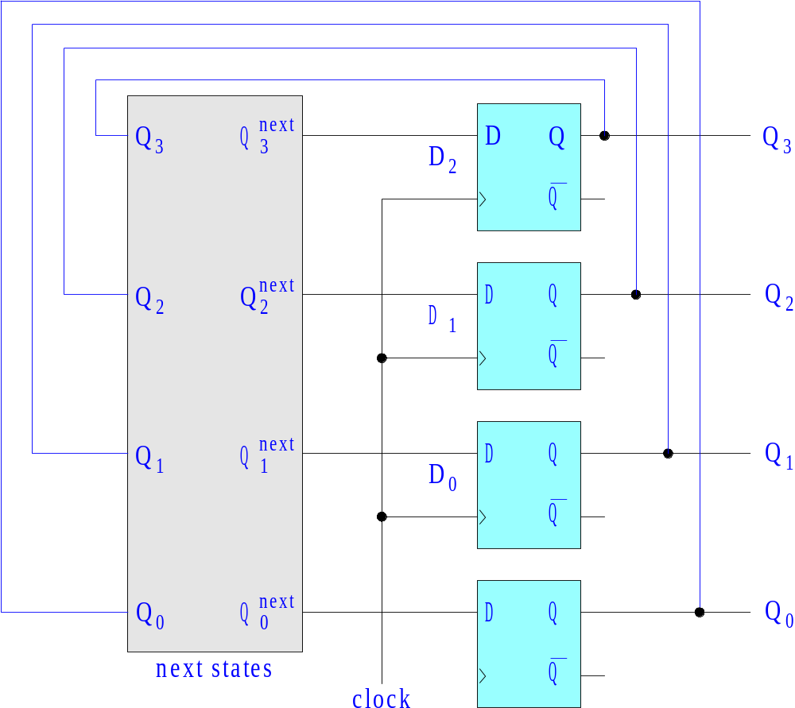
4-bit binary counter
Example 2

Slide 53
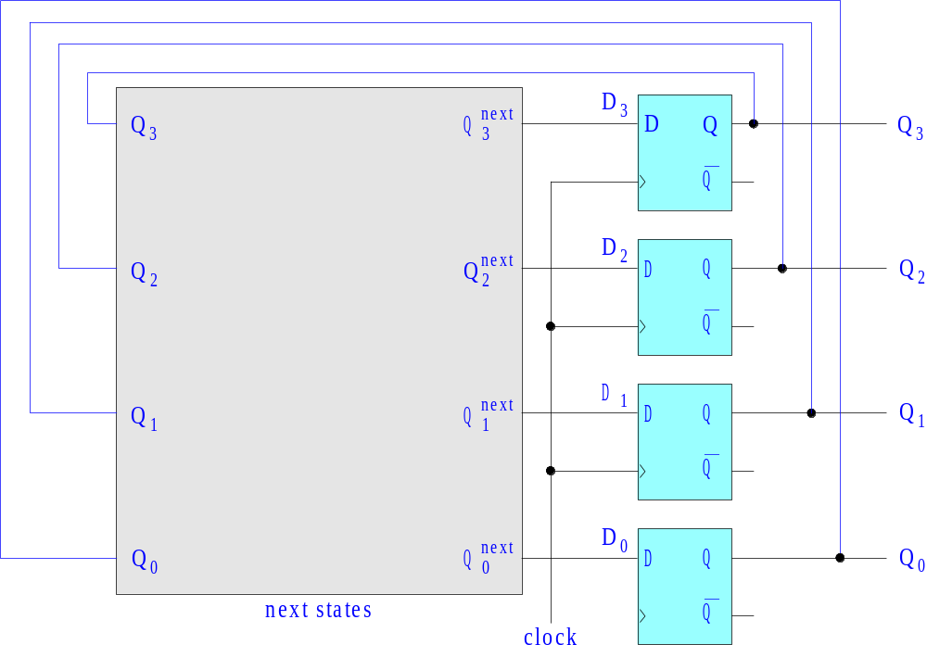
4-bit binary counter
Q₃^{next} = Q₃ ⊕ (Q₂ Q₁ Q₀)
Q₂^{next} = Q₂ ⊕ (Q₁ Q₀)
Q₁^{next} = Q₁ ⊕ Q₀
Q₀^{next} = Q₀ ⊕ 1 = Q₀ʹ
Example 2

Slide 54
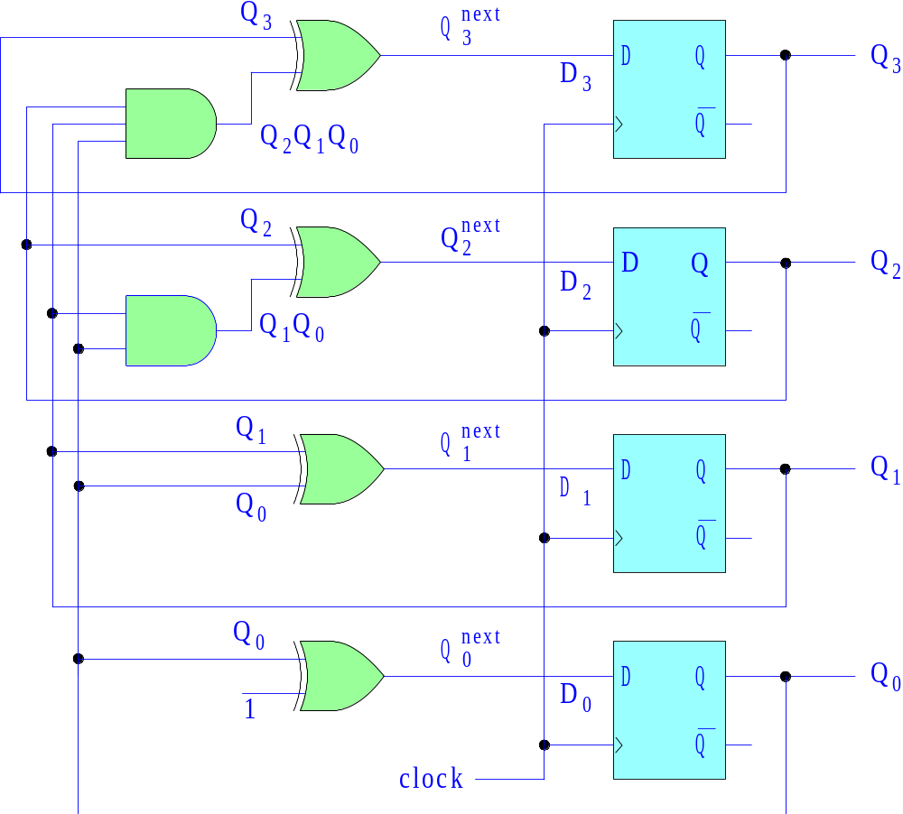
next states
4-bit binary counter
Q₃^{next} = Q₃ ⊕ (Q₂ Q₁ Q₀)
Q₂^{next} = Q₂ ⊕ (Q₁ Q₀)
Q₁^{next} = Q₁ ⊕ Q₀
Q₀^{next} = Q₀ ⊕ 1 = Q₀ʹ
Example 2

Slide 55
Q₃Q₂
4-bit binary counter
next states
s_{t} Q₃ Q₂ Q₁ Q₀ Q₃ Q₂ Q₁ Q₀
0 0 0 0 0 0 0 0 1
1 0 0 0 1 0 0 1 0
2 0 0 1 0 0 0 1 1
3 0 0 1 1 0 1 0 0
4 0 1 0 0 0 1 0 1
5 0 1 0 1 0 1 1 0
6 0 1 1 0 0 1 1 1
7 0 1 1 1 1 0 0 0
8 1 0 0 0 1 0 0 1
9 1 0 0 1 1 0 1 0
10 1 0 1 0 1 0 1 1
11 1 0 1 1 1 1 0 0
12 1 1 0 0 1 1 0 1
13 1 1 0 1 1 1 1 0
14 1 1 1 0 1 1 1 1
15 1 1 1 1 0 0 0 0
Q₁Q₀
00
01
11
10
Q₃^{next} = Q₃ ⊕ (Q₂ Q₁ Q₀)
Q₂^{next} = Q₂ ⊕ (Q₁ Q₀)
Q₁^{next} = Q₁ ⊕ Q₀
Q₀^{next} = Q₀ ⊕ 1 = Q₀ʹ
00
1
1
1
1
Q₀^{next} = Q₀ʹ = Q₀ ⊕ 1
01
11
10
1
1
1
1
Q₃Q₂
Q₁Q₀
00
01
11
10
00
01
1
1
1
1
11
a ⊕ b = a bʹ + aʹ b
Q₁^{next} = Q₁ Q₀ʹ + Q₁ʹ Q₀ = Q₁ ⊕ Q₀
10
1
1
1
1
Example 2

Slide 56
Q₃Q₂
4-bit binary counter
next states
s_{t} Q₃ Q₂ Q₁ Q₀ Q₃ Q₂ Q₁ Q₀
0 0 0 0 0 0 0 0 1
1 0 0 0 1 0 0 1 0
2 0 0 1 0 0 0 1 1
3 0 0 1 1 0 1 0 0
4 0 1 0 0 0 1 0 1
5 0 1 0 1 0 1 1 0
6 0 1 1 0 0 1 1 1
7 0 1 1 1 1 0 0 0
8 1 0 0 0 1 0 0 1
9 1 0 0 1 1 0 1 0
10 1 0 1 0 1 0 1 1
11 1 0 1 1 1 1 0 0
12 1 1 0 0 1 1 0 1
13 1 1 0 1 1 1 1 0
14 1 1 1 0 1 1 1 1
15 1 1 1 1 0 0 0 0
Q₁Q₀
00
01
11
10
Q₃^{next} = Q₃ ⊕ (Q₂ Q₁ Q₀)
Q₂^{next} = Q₂ ⊕ (Q₁ Q₀)
Q₁^{next} = Q₁ ⊕ Q₀
Q₀^{next} = Q₀ ⊕ 1 = Q₀ʹ
00
1
1
Q₂^{next} = Q₂ Q₁ʹ + Q₂ Q₀ʹ + Q₂ʹ Q₁ Q₀
= Q₂ (Q₁ʹ + Q₀ʹ) + Q₂ʹ (Q₁ Q₀)
= Q₂ ⊕ (Q₁ Q₀)
01
1
1
11
1
1
Q₃Q₂
10
1
1
Q₁Q₀
00
01
11
10
00
1
1
01
1
1
Q₃^{next} = Q₃ Q₁ʹ +Q₃ Q₂ʹ +Q₃ Q₀ʹ +Q₃ʹ Q₂ Q₁ Q₀
= Q₃ (Q₁ʹ + Q₂ʹ + Q₀ʹ) + Q₃ʹ Q₂ Q₁ Q₀
= Q₃ ⊕ (Q₂ Q₁ Q₀)
11
1
1
10
1
1
Example 2

Slide 57
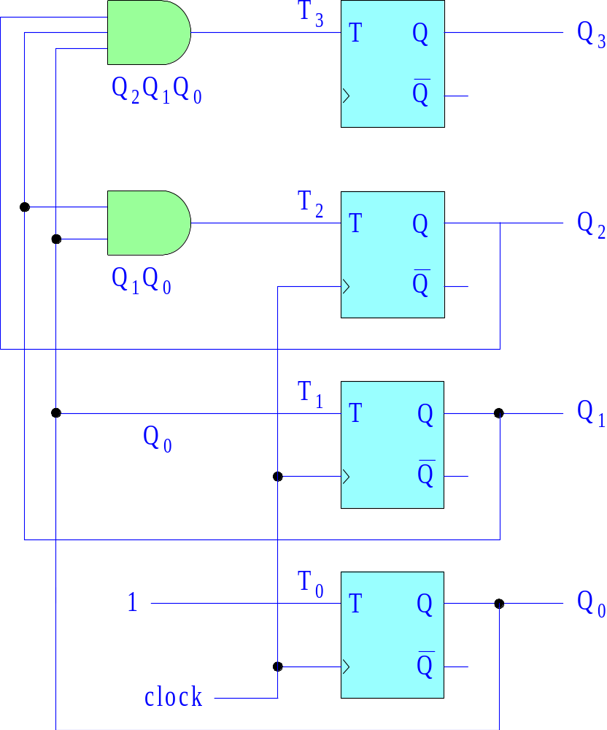
4-bit binary counter
using T-flip-flops
Q₃^{next} = Q₃ ⊕ (Q₂ Q₁ Q₀)
Q₂^{next} = Q₂ ⊕ (Q₁ Q₀)
Q₁^{next} = Q₁ ⊕ Q₀
Q₀^{next} = Q₀ ⊕ 1 = Q₀ʹ
characteristic equation
of T-flip-flop
Q^{next} = Q ⊕ T
T₃ = Q₂ Q₁ Q₀
T₂ = Q₁ Q₀
T₁ = Q₀
T₀ = 1
Example 2

Slide 58
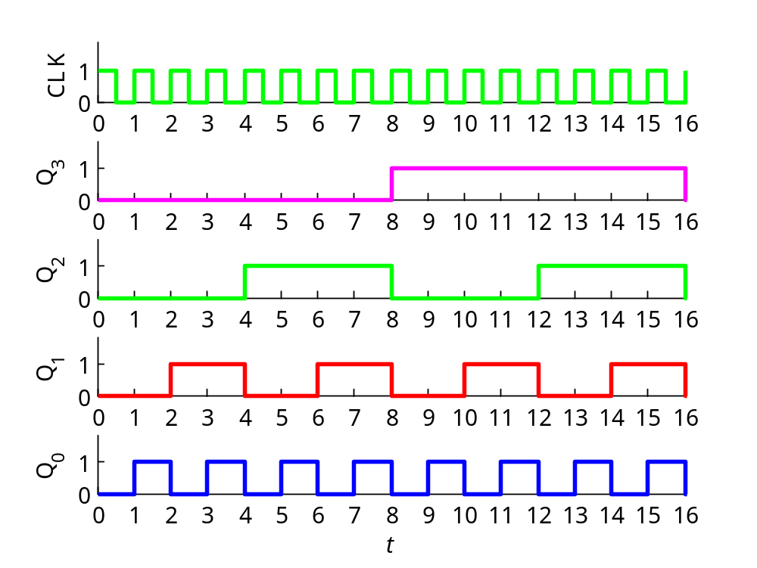
4-bit binary counter
file: count4a.m
s_{t} Q₃ Q₂ Q₁ Q₀
0 0 0 0 0
1 0 0 0 1
2 0 0 1 0
3 0 0 1 1
4 0 1 0 0
5 0 1 0 1
6 0 1 1 0
7 0 1 1 1
8 1 0 0 0
9 1 0 0 1
10 1 0 1 0
11 1 0 1 1
12 1 1 0 0
13 1 1 0 1
14 1 1 1 0
15 1 1 1 1
Note on clock dividers: the individual bit-outputs can be used as clock signals of lower frequencies. For an N-bit binary counter,
Q_{n} has 1/2^{n+1}, the frequency of the clock, for n=0,1,…, N-1
Example 2

Slide 59
4-bit binary counter
s_{t} Q₃ Q₂ Q₁ Q₀
0 0 0 0 0
1 0 0 0 1
2 0 0 1 0
3 0 0 1 1
4 0 1 0 0
5 0 1 0 1
6 0 1 1 0
7 0 1 1 1
8 1 0 0 0
9 1 0 0 1
10 1 0 1 0
11 1 0 1 1
12 1 1 0 0
13 1 1 0 1
14 1 1 1 0
15 1 1 1 1
Example: 100 kHz Emona clock divided down to 100 Hz.
use 10-bit counter and pick Q₉ bit as clock:
100 kHz / 2⁹⁺¹ =
= 97.6563 Hz
with, 102.4 kHz =
= 1024 x 100 Hz
1024 x 100 / 2⁹⁺¹ =
= 100 Hz
Note on clock dividers: the individual bit-outputs can be used as clock signals of lower frequencies. For an N-bit binary counter,
Q_{n} has 1/2^{n+1}, the frequency of the clock, for n=0,1,…, N-1
Example 2

Slide 60
Example 3 – traffic light controller. Counters can be used to generate time intervals for task control. Here, we will use a 3-bit counter to generate the red, green, yellow signals of a traffic light. Since a 3-bit counter repeats every 8 time periods, we will assume for simplicity that the green light stays on for 4 periods, then, the yellow light comes on for 1 period, and then the red light comes on for 3 periods, and the whole process repeats.
We start by translating these design requirements into a truth table.
next states outputs
t Q₂ Q₁ Q₀ Q₂ Q₁ Q₀ G Y R
0 0 0 0 0 0 1 1 0 0
1 0 0 1 0 1 0 1 0 0
2 0 1 0 0 1 1 1 0 0
3 0 1 1 1 0 0 1 0 0
4 1 0 0 1 0 1 0 1 0
5 1 0 1 1 1 0 0 0 1
6 1 1 0 1 1 1 0 0 1
7 1 1 1 0 0 0 0 0 1
G = Q₂ʹ
Y = Q₂ Q₁ʹ Q₀ʹ
R = Q₂ Q₁ + Q₂ Q₀
3-bit counter
Example 3

Slide 61
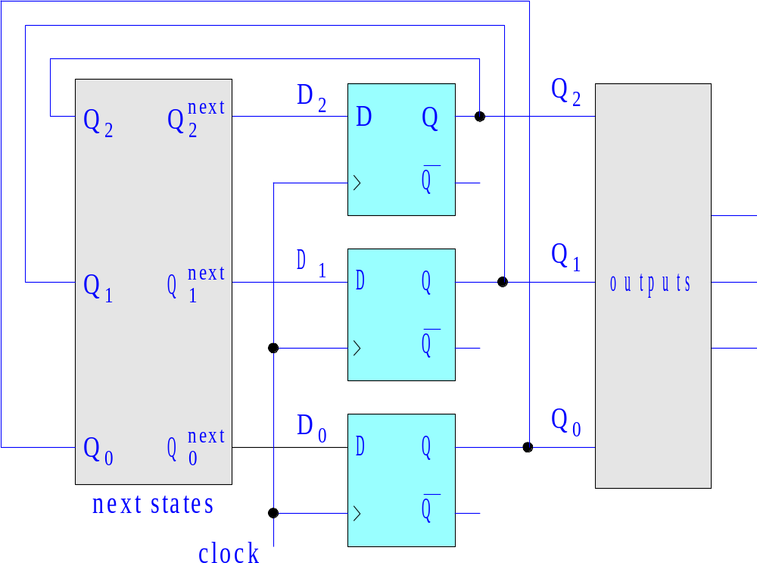
the counter generates the sequence of states, Q₂Q₁Q₀, which, in turn, generate the green, yellow, red output signals
G
G = Q₂ʹ
Y = Q₂ Q₁ʹ Q₀ʹ
R = Q₂ Q₁ + Q₂ Q₀
Y
R
Example 3

Slide 62
next states outputs
t Q₂ Q₁ Q₀ Q₂ Q₁ Q₀ G Y R
0 0 0 0 0 0 1 1 0 0
1 0 0 1 0 1 0 1 0 0
2 0 1 0 0 1 1 1 0 0
3 0 1 1 1 0 0 1 0 0
4 1 0 0 1 0 1 0 1 0
5 1 0 1 1 1 0 0 0 1
6 1 1 0 1 1 1 0 0 1
7 1 1 1 0 0 0 0 0 1
Q₂Q₁
Q₀
00
01
11
10
0
1
1
1
1
1
G = Q₂ʹ
G = Q₂ʹ
Y = Q₂ Q₁ʹ Q₀ʹ
R = Q₂ Q₁ + Q₂ Q₀
Q₂Q₁
Q₂Q₁
Q₀
00
01
11
10
Q₀
00
01
11
10
0
1
0
1
1
1
1
1
Y = Q₂ Q₁ʹ Q₀ʹ
R = Q₂ Q₁ + Q₂ Q₀
Example 3

Slide 63
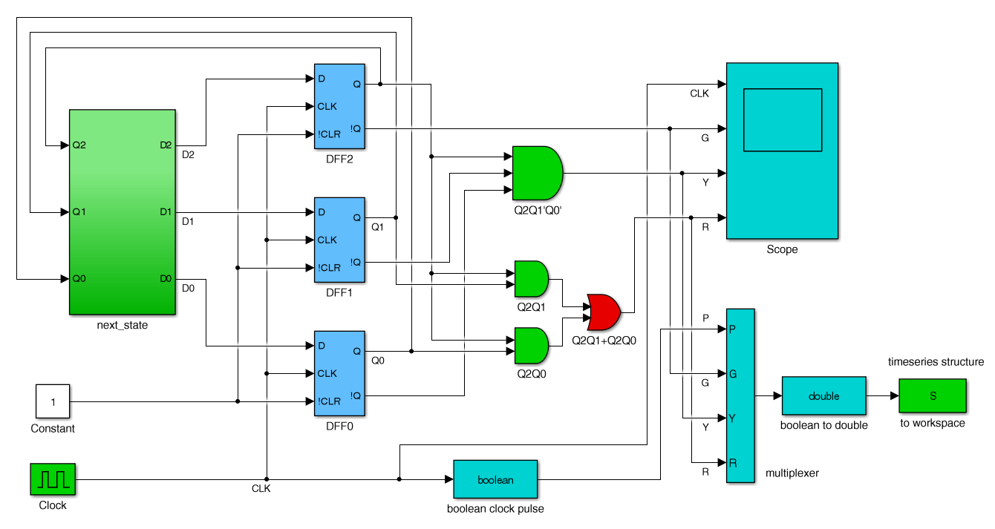
3-bit counter
G, Y, R
outputs
G = Q₂ʹ
Y = Q₂ Q₁ʹ Q₀ʹ
R = Q₂ Q₁ + Q₂ Q₀
file: GYR3a.slx
Example 3

Slide 64
Q₂^{next} = Q₂ ⊕ (Q₁ Q₀)
Q₁^{next} = Q₁ ⊕ Q₀
Q₀^{next} = Q₀ ⊕ 1 = Q₀ʹ
next-state sub-function
for a 3-bit counter
Example 1

Slide 65
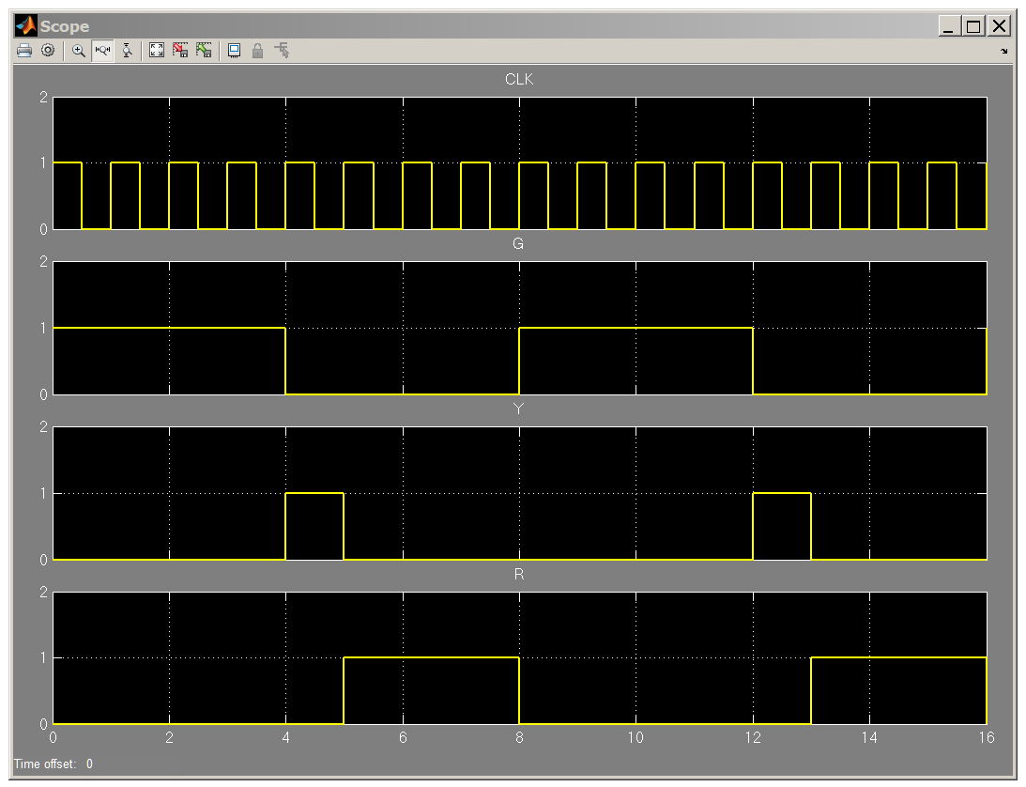
scope
output
G
Y
R
Example 3

Slide 66
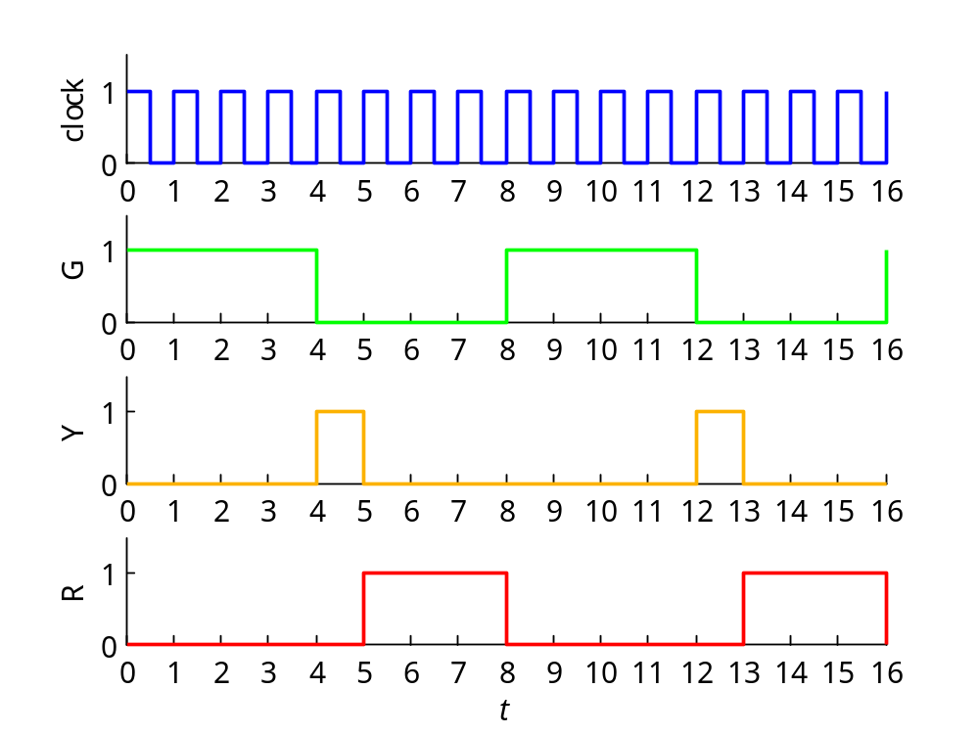
G
Y
R
Example 3

Slide 67
Example 4 – traffic light controller. In a variation of the previous example, design a traffic controller that is sequenced in the order red-green-yellow,
as opposed to previous order of green-yellow-red.
The corresponding truth table and design equations are now:
next states outputs
t Q₂ Q₁ Q₀ Q₂ Q₁ Q₀ R G Y
0 0 0 0 0 0 1 1 0 0
1 0 0 1 0 1 0 1 0 0
2 0 1 0 0 1 1 1 0 0
3 0 1 1 1 0 0 0 1 0
4 1 0 0 1 0 1 0 1 0
5 1 0 1 1 1 0 0 1 0
6 1 1 0 1 1 1 0 1 0
7 1 1 1 0 0 0 0 0 1
R = Q₂ʹ Q₁ʹ + Q₂ʹ Q₀ʹ
G = Q₂ ⊕ (Q₁Q₀)
Y = Q₂ Q₁ Q₀
Example 4

Slide 68
the counter generates the sequence of states, Q₂Q₁Q₀, which, in turn, generate the red, green, yellow output signals
R = Q₂ʹ Q₁ʹ + Q₂ʹ Q₀ʹ
G = Q₂ ⊕ (Q₁Q₀)
Y = Q₂ Q₁ Q₀
R
G
Y
Example 4

Slide 69
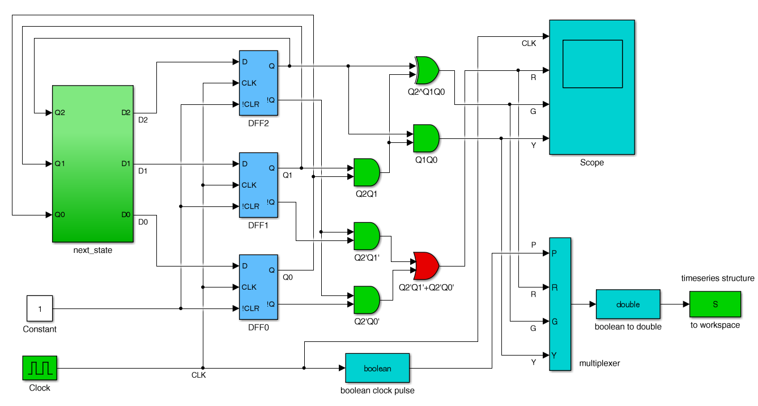
R, G, Y
outputs
3-bit counter
R = Q₂ʹ Q₁ʹ + Q₂ʹ Q₀ʹ
G = Q₂ ⊕ (Q₁Q₀)
Y = Q₂ Q₁ Q₀
file: GYR3b.slx
Example 4

Slide 70
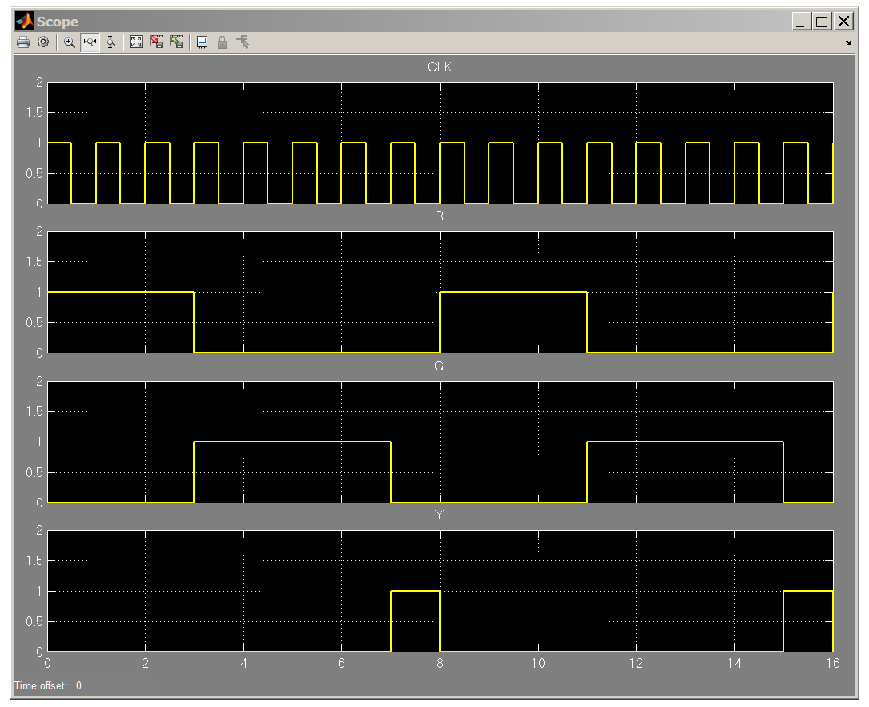
scope
output
R
G
Y
Example 4

Slide 71
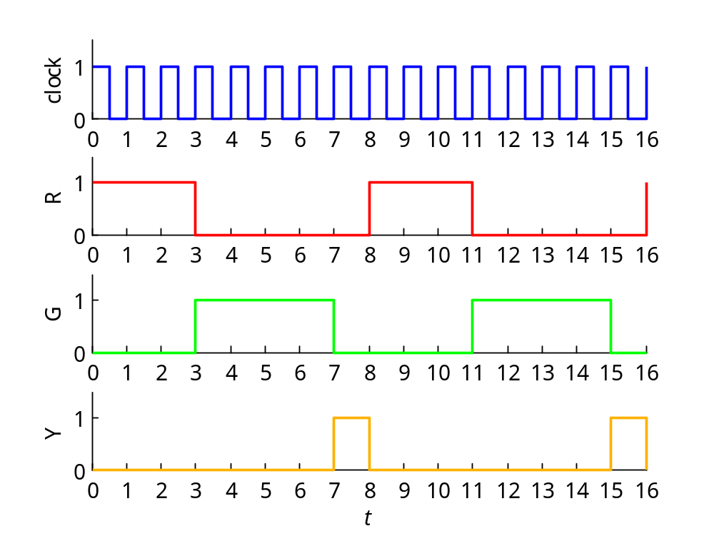
R
G
Y
Example 4

Slide 72
Example 5 – generating arbitrary sequences. It is desired to design a counter that generates the following repeating length-8 sequence of numbers:
[0, 6, 2, 4, 1, 7, 3, 5]
Using three bits, Q₂Q₁Q₀, to represent these numbers, the corresponding characteristic table, counting in the above order, will be as follows.
files:
count3abc.m
count3a.slx
count3b.slx
count3c.slx
next states
s_{t} Q₂ Q₁ Q₀ Q₂ Q₁ Q₀
0 0 0 0 1 1 0
6 1 1 0 0 1 0
2 0 1 0 1 0 0
4 1 0 0 0 0 1
1 0 0 1 1 1 1
7 1 1 1 0 1 1
3 0 1 1 1 0 1
5 1 0 1 0 0 0
Q₂^{next} = Q₂ʹ
Q₁^{next} = (Q₂ ⊕ Q₁)ʹ
Q₀^{next} = Q₀ ⊕ (Q₂Q₁ʹ)
repeat
a ⊕ b = a bʹ + aʹ b
recall: (a ⊕ b)ʹ = a b + aʹ bʹ
Example 5

Slide 73
realization using D flip-flops
Q₂^{next} = Q₂ʹ
Q₁^{next} = (Q₂ ⊕ Q₁)ʹ
Q₀^{next} = Q₀ ⊕ (Q₂Q₁ʹ)
Example 5

Slide 74
next states
s_{t} Q₂ Q₁ Q₀ Q₂ Q₁ Q₀
0 0 0 0 1 1 0
6 1 1 0 0 1 0
2 0 1 0 1 0 0
4 1 0 0 0 0 1
1 0 0 1 1 1 1
7 1 1 1 0 1 1
3 0 1 1 1 0 1
5 1 0 1 0 0 0
Q₂Q₁
Q₀
00
01
11
10
0
1
1
1
1
1
Q₂^{next} = Q₂ʹ
Q₁^{next} = (Q₂ ⊕ Q₁)ʹ
Q₀^{next} = Q₀ ⊕ (Q₂Q₁ʹ)
Q₂^{next} = Q₂ʹ
Q₂Q₁
Q₀
00
01
11
10
Q₂Q₁
Q₀
00
01
11
10
0
1
0
1
1
1
1
1
1
1
1
1
a ⊕ b = a bʹ + aʹ b
Q₀^{next} = Q₂ʹ Q₀ + Q₁ Q₀ + Q₂ Q₁ʹ Q₀ʹ
= Q₀ ⊕ (Q₂Q₁ʹ)
(a ⊕ b)ʹ = a b + aʹ bʹ
Q₁^{next} = Q₂ʹ Q₁ʹ + Q₂ Q₁ = (Q₂ ⊕ Q₁)ʹ
Example 5

Slide 75
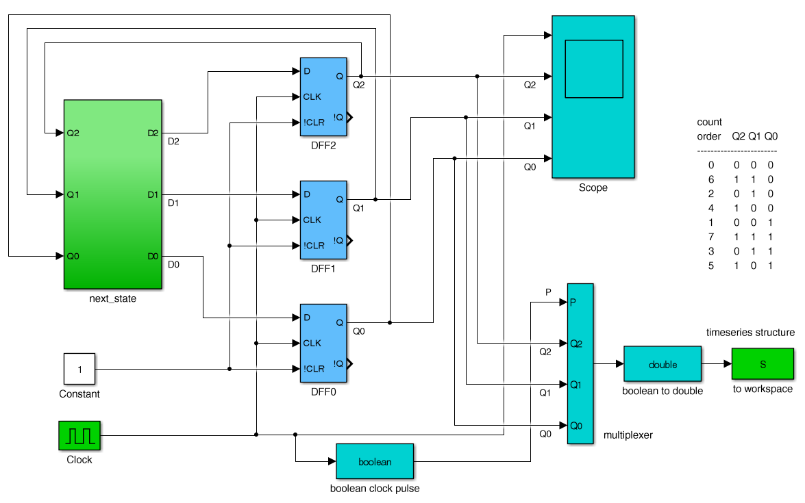
Simulink implementation
Q₂^{next} = Q₂ʹ
Q₁^{next} = (Q₂ ⊕ Q₁)ʹ
Q₀^{next} = Q₀ ⊕ (Q₂Q₁ʹ)
Example 5

Slide 76
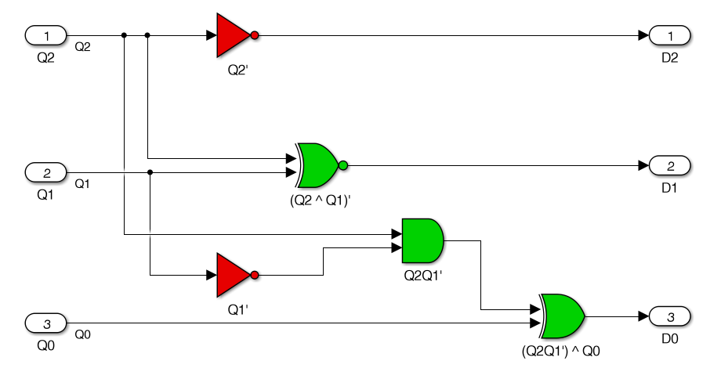
Q₂^{next} = Q₂ʹ
Q₁^{next} = (Q₂ ⊕ Q₁)ʹ
Q₀^{next} = Q₀ ⊕ (Q₂Q₁ʹ)
next-state subfunction
Example 5

Slide 77
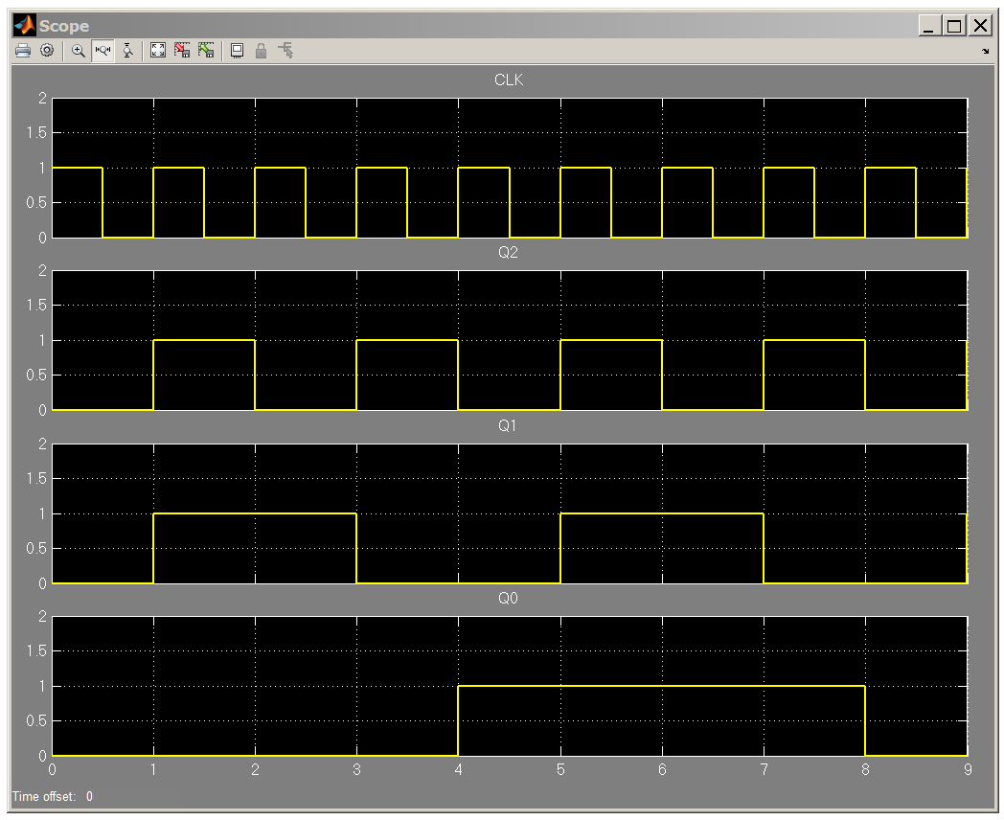
scope
output
0 6 2 4 1 7 3 5 0
repeat
Example 5

Slide 78
% plot timing diagram from exported Simulink data
t = S.time; % time
P = S.data(:,1); % clock pulse
Q2 = S.data(:,2);
Q1 = S.data(:,3);
Q0 = S.data(:,4);
figure;
subplot(4,1,1); stairs(t,P,'g-’);
subplot(4,1,2); stairs(t,Q2,'b-’);
subplot(4,1,3); stairs(t,Q1,'r-’);
subplot(4,1,4); stairs(t,Q0,'m-’);
xlabel('{\itt}')
Example 5

Slide 79
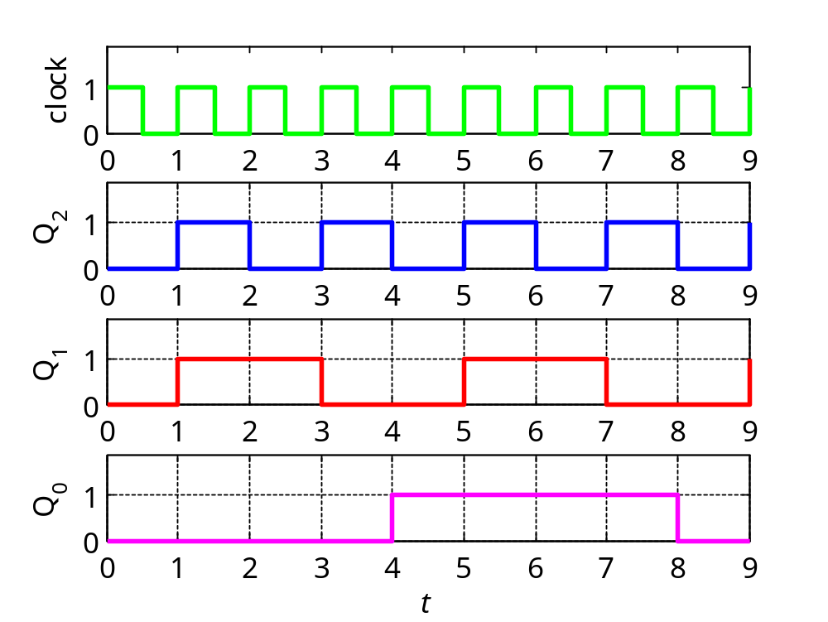
timing diagram
0 6 2 4 1 7 3 5 0
repeat
Example 5

Slide 80
Example 6 – generating a sub-sequence. Design a counter that generates the following repeating length-6 sub-sequence of the previous example,
[0, 6, 2, 4, 1, 7]
Using three bits, Q₂Q₁Q₀, to represent these numbers, the corresponding characteristic table, counting in the above order, will be as follows.
files:
count3abc.m
count3a.slx
count3b.slx
count3c.slx
Example 5 case:
Q₂^{next} = Q₂ʹ
Q₁^{next} = (Q₂ ⊕ Q₁)ʹ
Q₀^{next} = Q₀ ⊕ (Q₂Q₁ʹ)
next states
s_{t} Q₂ Q₁ Q₀ Q₂ Q₁ Q₀
0 0 0 0 1 1 0
6 1 1 0 0 1 0
2 0 1 0 1 0 0
4 1 0 0 0 0 1
1 0 0 1 1 1 1
7 1 1 1 0 0 0
3 0 1 1 x x x
5 1 0 1 x x x
Q₂^{next} = Q₂ʹ
Q₁^{next} = Q₂ʹ Q₁ʹ + Q₂ Q₁ Q₀ʹ
Q₀^{next} = Q₂ Q₁ʹ + Q₂ʹ Q₀
repeat
don’t cares
Example 6

Slide 81
realization using D flip-flops
Q₂^{next} = Q₂ʹ
Q₁^{next} = Q₂ʹ Q₁ʹ + Q₂ Q₁ Q₀ʹ
Q₀^{next} = Q₂ Q₁ʹ + Q₂ʹ Q₀
Example 6

Slide 82
next states
s_{t} Q₂ Q₁ Q₀ Q₂ Q₁ Q₀
0 0 0 0 1 1 0
6 1 1 0 0 1 0
2 0 1 0 1 0 0
4 1 0 0 0 0 1
1 0 0 1 1 1 1
7 1 1 1 0 0 0
3 0 1 1 x x x
5 1 0 1 x x x
Q₂Q₁
Q₀
00
01
11
10
0
1
1
1
1
x
x
Q₂^{next} = Q₂ʹ
Q₂^{next} = Q₂ʹ
Q₁^{next} = Q₂ʹ Q₁ʹ + Q₂ Q₁ Q₀ʹ
Q₀^{next} = Q₂ Q₁ʹ + Q₂ʹ Q₀
Q₂Q₁
Q₂Q₁
Q₀
Q₀
00
01
11
10
00
01
11
10
0
1
1
0
1
1
1
x
x
1
1
x
x
Q₁^{next} = Q₂ʹ Q₁ʹ + Q₂ Q₁ Q₀ʹ
Q₀^{next} = Q₂ Q₁ʹ + Q₂ʹ Q₀
Example 6

Slide 83
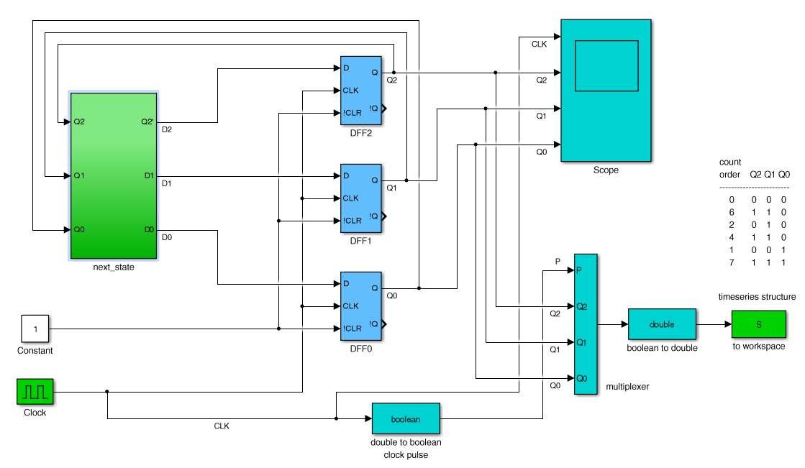
Simulink implementation
Q₂^{next} = Q₂ʹ
Q₁^{next} = Q₂ʹ Q₁ʹ + Q₂ Q₁ Q₀ʹ
Q₀^{next} = Q₂ Q₁ʹ + Q₂ʹ Q₀
Example 6

Slide 84
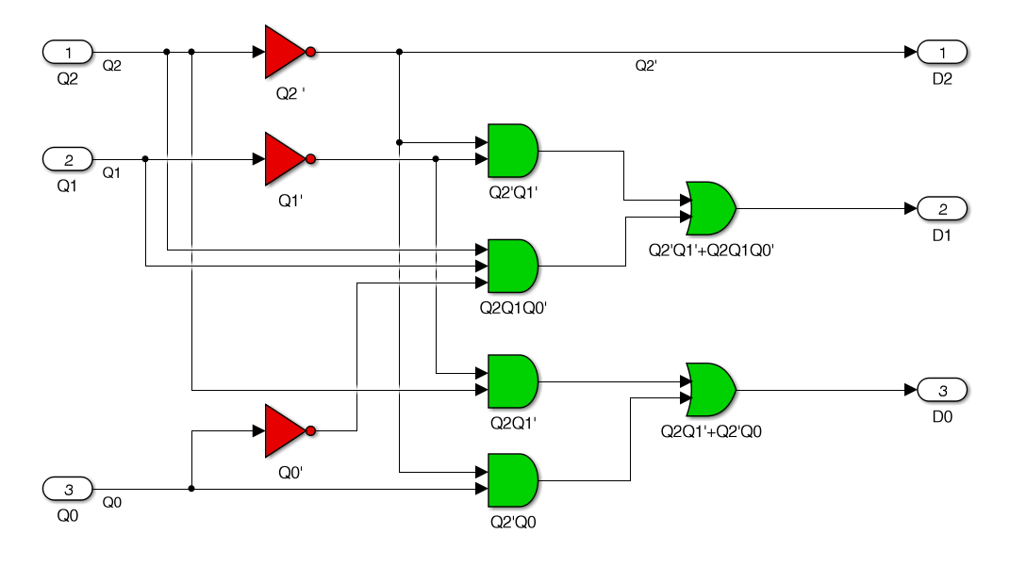
Q₂^{next} = Q₂ʹ
Q₁^{next} = Q₂ʹ Q₁ʹ + Q₂ Q₁ Q₀ʹ
Q₀^{next} = Q₂ Q₁ʹ + Q₂ʹ Q₀
next-state subfunction
Example 6

Slide 85
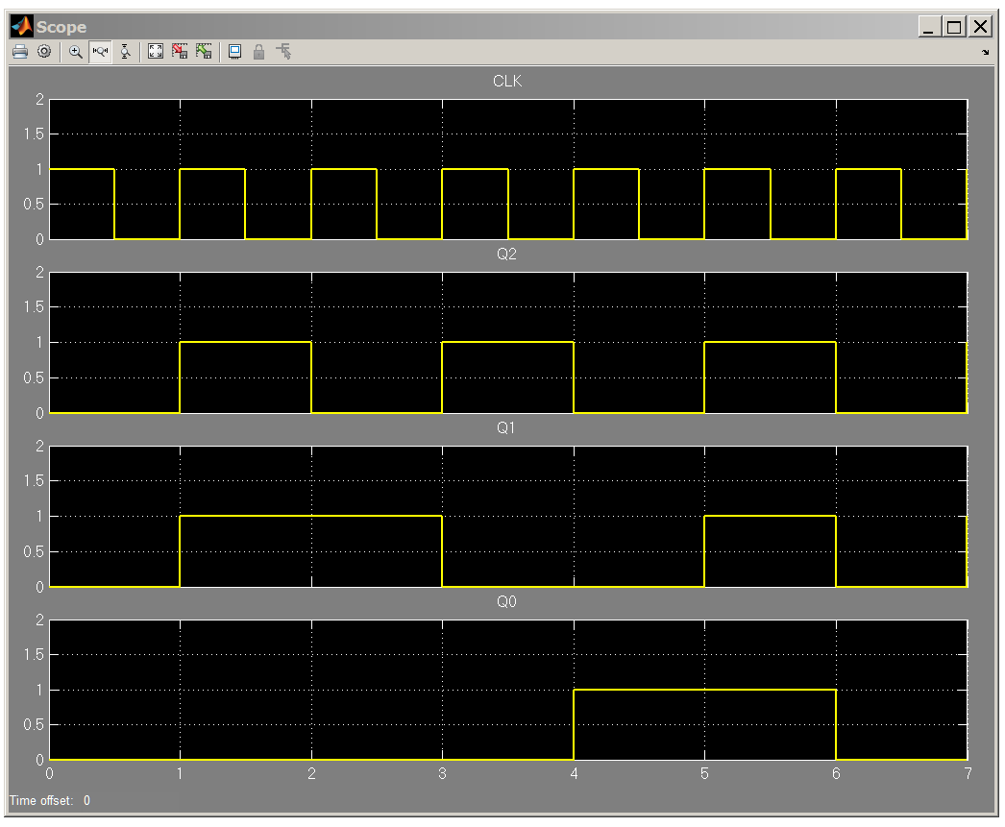
scope
output
0 6 2 4 1 7 0
repeat
repeat
Example 6

Slide 86
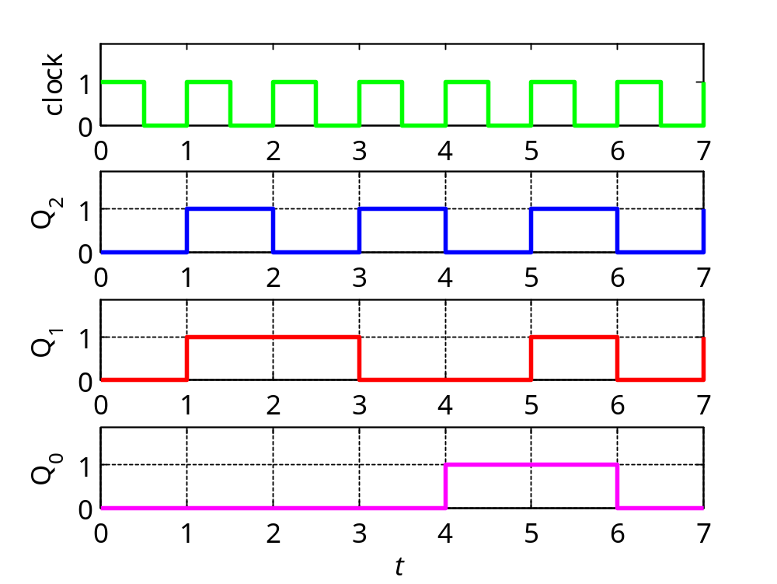
timing diagram
0 6 2 4 1 7 0
repeat
Example 6

Slide 87
Example 7 – generating a sub-sequence. Design a counter that generates the following repeating length-5 sub-sequence of Example-5,
[0, 6, 2, 4, 1]
Using three bits, Q₂Q₁Q₀, to represent these numbers, the corresponding characteristic table, counting in the above order, will be as follows.
files:
count3abc.m
count3a.slx
count3b.slx
count3c.slx
next states
s_{t} Q₂ Q₁ Q₀ Q₂ Q₁ Q₀
0 0 0 0 1 1 0
6 1 1 0 0 1 0
2 0 1 0 1 0 0
4 1 0 0 0 0 1
1 0 0 1 0 0 0
7 1 1 1 x x x
3 0 1 1 x x x
5 1 0 1 x x x
Q₂^{next} = Q₂ʹ Q₀ʹ
Q₁^{next} = Q₂ Q₁ + Q₂ʹ Q₁ʹ Q₀ʹ
Q₀^{next} = Q₂ Q₁ʹ
repeat
don’t cares
Example 7

Slide 88
realization using D flip-flops
Q₂^{next} = Q₂ʹ Q₀ʹ
Q₁^{next} = Q₂Q₁ + Q₂ʹ Q₁ʹ Q₀ʹ
Q₀^{next} = Q₂ Q₁ʹ
Example 7

Slide 89
next states
s_{t} Q₂ Q₁ Q₀ Q₂ Q₁ Q₀
0 0 0 0 1 1 0
6 1 1 0 0 1 0
2 0 1 0 1 0 0
4 1 0 0 0 0 1
1 0 0 1 0 0 0
7 1 1 1 x x x
3 0 1 1 x x x
5 1 0 1 x x x
Q₂Q₁
Q₀
00
01
11
10
0
1
1
1
x
x
x
Q₂^{next} = Q₂ʹ Q₀ʹ
Q₁^{next} = Q₂Q₁ + Q₂ʹ Q₁ʹ Q₀ʹ
Q₀^{next} = Q₂ Q₁ʹ
Q₂^{next} = Q₂ʹ Q₀ʹ
Q₂Q₁
Q₂Q₁
Q₀
Q₀
00
01
11
10
00
01
11
10
0
1
1
0
1
1
x
x
x
1
x
x
x
Q₁^{next} = Q₂ Q₁ + Q₂ʹ Q₁ʹ Q₀ʹ
Q₀^{next} = Q₂ Q₁ʹ
Example 7

Slide 90
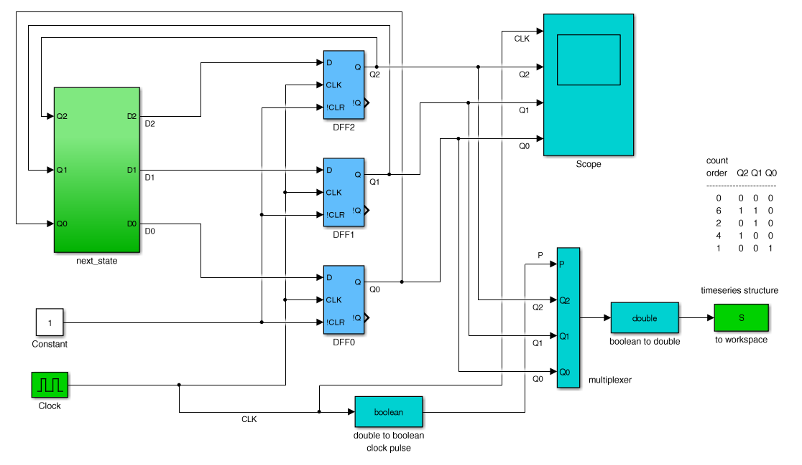
Simulink implementation
Q₂^{next} = Q₂ʹ Q₀ʹ
Q₁^{next} = Q₂Q₁ + Q₂ʹ Q₁ʹ Q₀ʹ
Q₀^{next} = Q₂ Q₁ʹ
Example 7

Slide 91
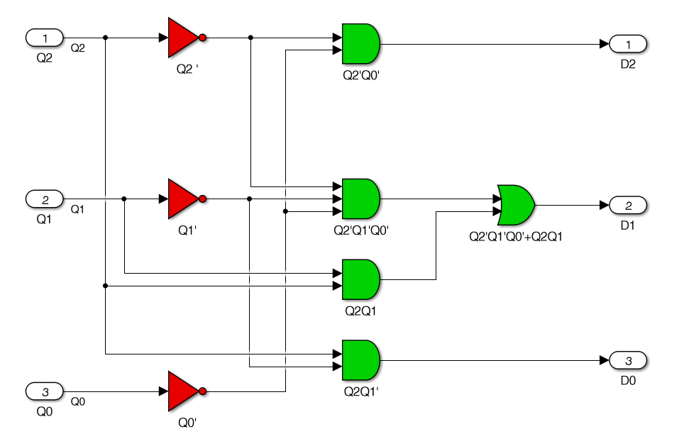
Q₂^{next} = Q₂ʹ Q₀ʹ
Q₁^{next} = Q₂Q₁ + Q₂ʹ Q₁ʹ Q₀ʹ
Q₀^{next} = Q₂ Q₁ʹ
next-state subfunction
Example 7

Slide 92
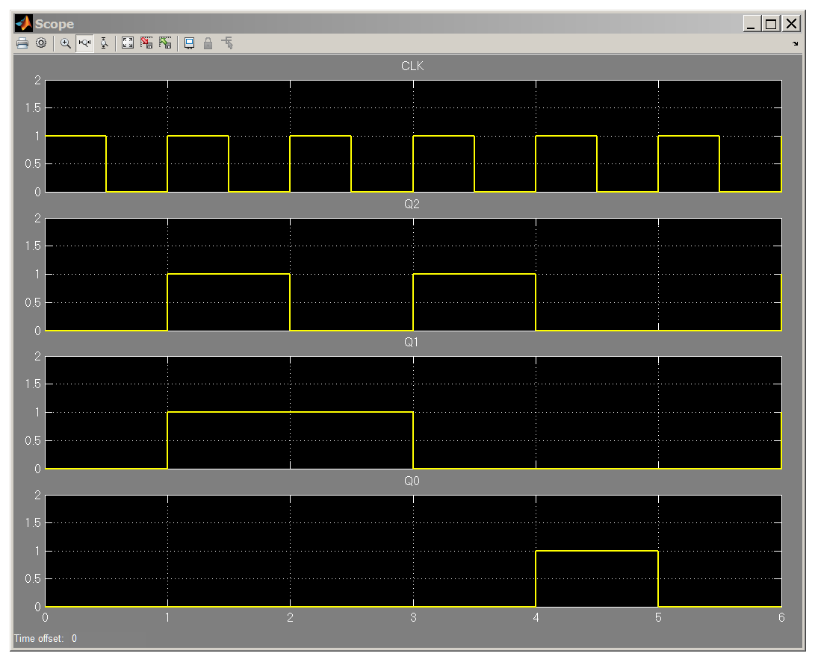
scope
output
0 6 2 4 1 0
repeat
Example 7

Slide 93
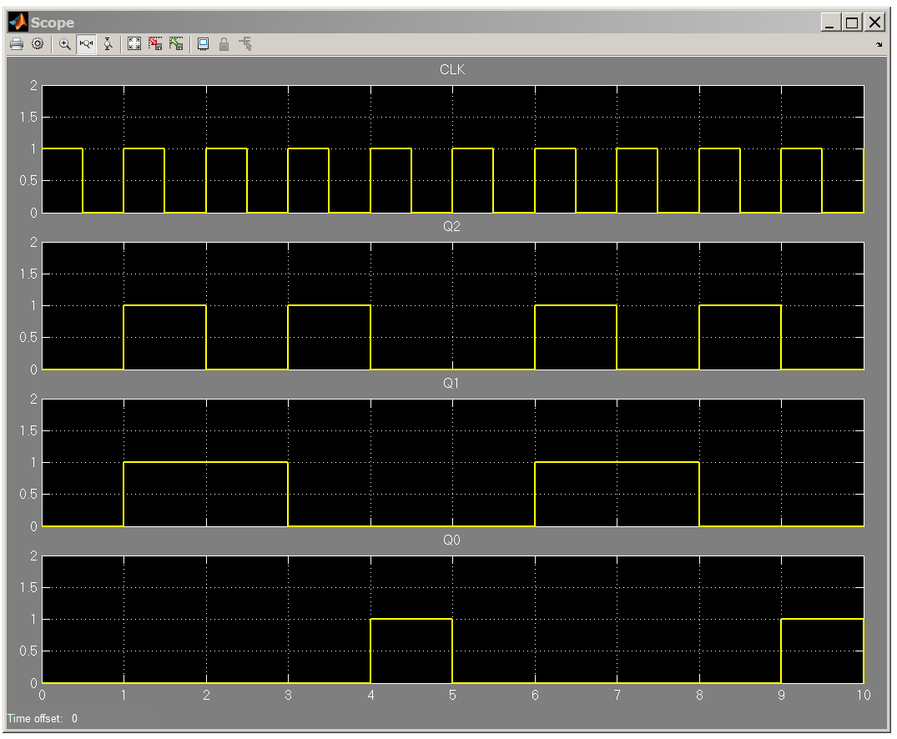
showing two periods
scope
output
0 6 2 4 1 0 6 2 4 1
repeat
Example 7

Slide 94
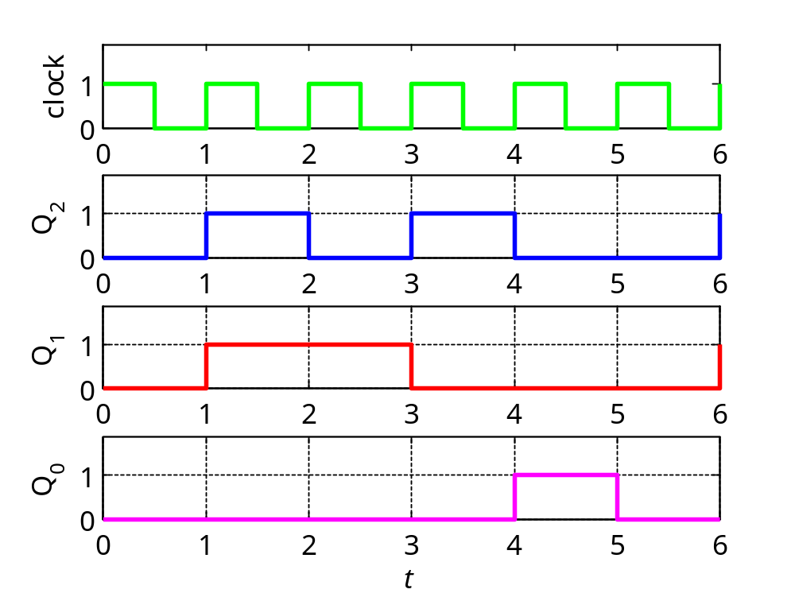
timing diagram
0 6 2 4 1 0
repeat
Example 7

Slide 95
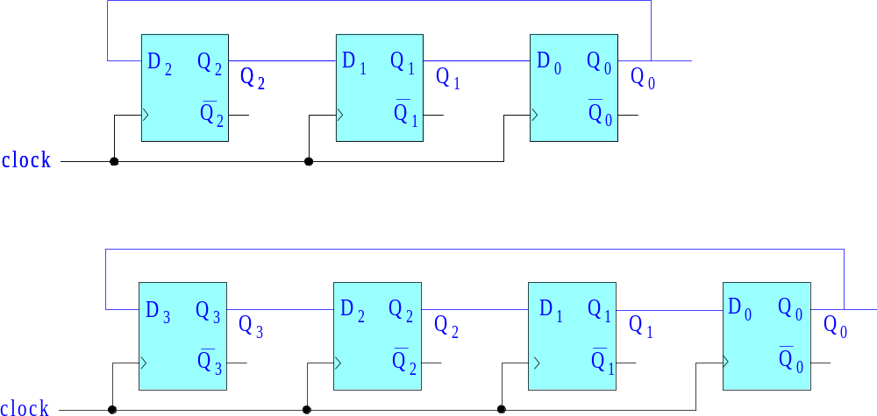
Example 8 – Ring counters. Ring counters are specialized counters implemented by feedback shift registers in which the last bit is fed back to the beginning. The 3-bit and 4-bit cases are shown below, and they cycle through the following binary patterns:
3-bit case: Q₂Q₁Q₀ = 100, 010, 001
4-bit case: Q₃Q₂Q₁Q₀ = 1000, 0100, 0010, 0001
similar to
one-hot
encoding
must be initialized to:
Q₂Q₁Q₀ = 100
Q₃Q₂Q₁Q₀ = 1000
Example 8

Slide 96
The feedback structure of the counter can also be derived using K-maps
assuming that the counter cycles through the patterns:
3-bit case: Q₂Q₁Q₀ = 100, 010, 001
4-bit case: Q₃Q₂Q₁Q₀ = 1000, 0100, 0010, 0001
for example, in the 3-bit case, we list the three desired patterns and the next ones, and treat all other patterns as “don’t’cares”,
next states
s_{t} Q₂ Q₁ Q₀ Q₂ Q₁ Q₀
4 1 0 0 0 1 0
2 0 1 0 0 0 1
1 0 0 1 1 0 0
0 0 0 0 x x x
3 0 1 1 x x x
5 1 0 1 x x x
6 1 1 0 x x x
7 1 1 1 x x x
must be initialized to:
Q₂Q₁Q₀ = 100
see p. 36 on how to
initialize a counter
repeat
don’t cares
Example 8

Slide 97
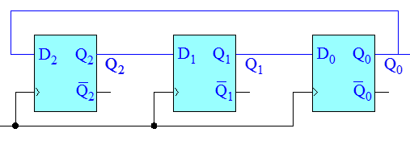
next states
s_{t} Q₂ Q₁ Q₀ Q₂ Q₁ Q₀
4 1 0 0 0 1 0
2 0 1 0 0 0 1
1 0 0 1 1 0 0
0 0 0 0 x x x
3 0 1 1 x x x
5 1 0 1 x x x
6 1 1 0 x x x
7 1 1 1 x x x
Q₂Q₁
Q₀
00
01
11
10
0
x
x
1
1
x
x
x
Q₂^{next} = Q₀
Q₂Q₁
Q₀
00
01
11
10
Q₂Q₁
Q₀
00
01
11
10
0
x
1
x
0
x
x
1
1
x
x
x
1
x
x
x
Q₀^{next} = Q₁
Q₁^{next} = Q₂
Example 8

Slide 98
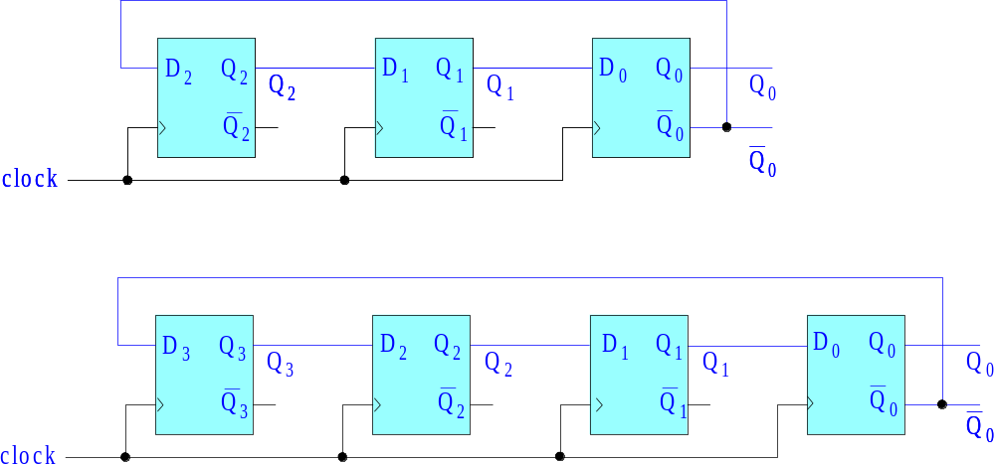
Example 9 – Johnson counters. Also known as twisted ring counters, they are specialized counters implemented by feedback shift registers in which the last bit is complemented and then fed back to the beginning. The 3-bit and 4-bit cases are shown below, and they cycle through the binary patterns:
3-bit case: Q₂Q₁Q₀ = 000, 100, 110, 111, 011, 001
4-bit case: Q₃Q₂Q₁Q₀ = 0000, 1000, 1100, 1110, 1111, 0111, 0011, 0001
must be initialized to:
Q₂Q₁Q₀ = 000
Q₃Q₂Q₁Q₀ = 0000
Example 9

Slide 99
The feedback structure of these counters can be derived using K-maps
assuming that the counter cycles through the specified patterns.
example, in the 3-bit case, we list the six desired patterns and the next ones, and treat all other patterns as “don’t’cares”,
Q₂Q₁Q₀ = 000, 100, 110, 111, 011, 001
next states
s_{t} Q₂ Q₁ Q₀ Q₂ Q₁ Q₀
0 0 0 0 1 0 0
4 1 0 0 1 1 0
6 1 1 0 1 1 1
7 1 1 1 0 1 1
3 0 1 1 0 0 1
1 0 0 1 0 0 0
2 0 1 0 x x x
5 1 0 1 x x x
repeat
don’t cares
Example 9

Slide 100
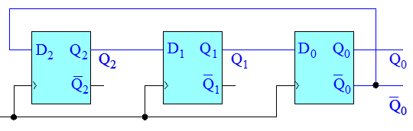
next states
s_{t} Q₂ Q₁ Q₀ Q₂ Q₁ Q₀
0 0 0 0 1 0 0
4 1 0 0 1 1 0
6 1 1 0 1 1 1
7 1 1 1 0 1 1
3 0 1 1 0 0 1
1 0 0 1 0 0 0
2 0 1 0 x x x
5 1 0 1 x x x
Q₂Q₁
Q₀
00
01
11
10
0
1
x
1
1
1
x
Q₂^{next} = Q₀ʹ
Q₂Q₁
Q₀
00
01
11
10
Q₂Q₁
Q₀
00
01
11
10
0
x
1
0
x
1
1
1
1
1
x
1
1
x
Q₀^{next} = Q₁
Q₁^{next} = Q₂
Example 9

Slide 101
Example 10 – Linear feedback shift registers (LFSR). LFSRs have similar structure as ring counters but with more complicated feedback connections using XOR gates. They can be designed to generate maximal-length pseudo-random sequences (i.e., maximal-length, 2^{n}-1, for n-bit registers) and have many uses in error-control coding, cryptography, testing of digital circuits, and digital communications.
Consider the following repeating length-7 “pseudo-random” sequence, mentioned in Wakerly, Sect. 11.2.5, Table 11-5:
s_{t} = [ 4, 2, 5, 6, 7, 3, 1, . . . ]
It turns out that this is a 3-bit maximal-length (2³-1 = 7) LFSR sequence and, in this example, we will start with the sequence and derive its realization and structure as a linear feedback shift register.
Three D flip flops will be required which must be initialized to the first values of that sequence, that is,
Q₂Q₁Q₀ = 100 (representing the decimal 4)
We begin by writing the truth table with 000 as a “don’t care entry”.
files:
lfsr34.m
lfsr3a.slx
lfsr4a.slx
Example 10

Slide 102
next states
s_{t} Q₂ Q₁ Q₀ Q₂ Q₁ Q₀
4 1 0 0 0 1 0
2 0 1 0 1 0 1
5 1 0 1 1 1 0
6 1 1 0 1 1 1
7 1 1 1 0 1 1
3 0 1 1 0 0 1
1 0 0 1 1 0 0
0 0 0 0 x x x
Q₂Q₁
Q₀
00
01
11
10
0
x
1
1
1
1
1
Q₂^{next} = Q₁ Q₀ʹ + Q₁ʹ Q₀ = Q₁ ⊕ Q₀
a ⊕ b = a bʹ + aʹ b
repeat
Q₂Q₁
Q₀
00
01
11
10
Q₂Q₁
Q₀
00
01
11
10
0
x
1
1
0
x
1
1
1
1
1
1
1
1
Q₀^{next} = Q₁
Q₁^{next} = Q₂
Example 10

Slide 103
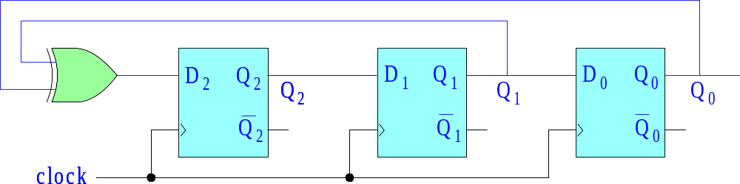
LFSR realization
initialize:
D₂ = 1
D₁ = 0
D₀ = 0
D₂ = Q₂^{next} = Q₁ ⊕ Q₀
D₁ = Q₁^{next} = Q₂
D₀ = Q₀^{next} = Q₁
Example 10

Slide 104
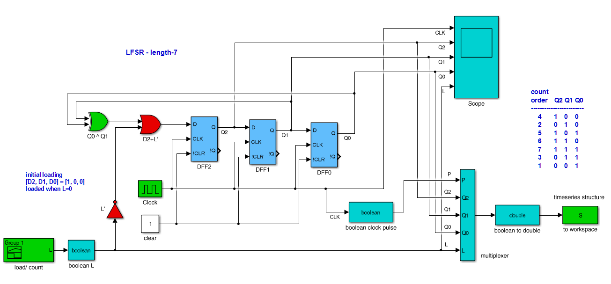
Simulink implementation
D₂ = Q₂^{next} = Q₁ ⊕ Q₀
D₁ = Q₁^{next} = Q₂
D₀ = Q₀^{next} = Q₁
initialization method is specific to this case,
D₂ = Lʹ + Q₁ ⊕ Q₀
load, L = 0
count, L = 1
Example 10

Slide 105
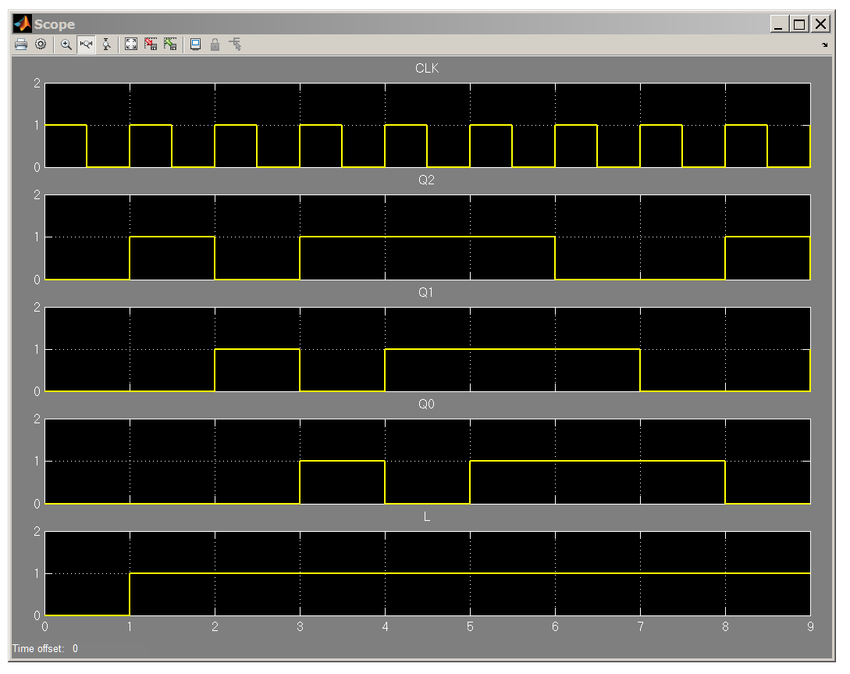
scope
output
count
load 4 2 5 6 7 3 1 4
repeat
Example 10

Slide 106

s_{t} = load 4 2 5 6 7 3 1 4 . . .
D₂ = Q₂^{next} = Q₁ ⊕ Q₀
D₁ = Q₁^{next} = Q₂
D₀ = Q₀^{next} = Q₁
load, L=0
count, L=1
repeat
Example 10

Slide 107
Example 10 - continued. Suppose we initialize at Q₂Q₁Q₀ = 011, and replace the next-state equations by,
Q₂^{next} = Q₂ ⊕ Q₀
Q₁^{next} = Q₂
Q₀^{next} = Q₁
then, what sequence will be generated? (practice exam initializes to Q₂Q₁Q₀ = 101)
Q₂^{next} = Q₂ ⊕ Q₀
Q₁^{next} = Q₂
Q₀^{next} = Q₁
next states
s_{t} Q₂ Q₁ Q₀ Q₂ Q₁ Q₀
3 0 1 1 * * *
* * * * * * *
* * * * * * *
* * * * * * *
* * * * * * *
* * * * * * *
* * * * * * *
0 0 0 0 x x x
next states
s_{t} Q₂ Q₁ Q₀ Q₂ Q₁ Q₀
3 0 1 1 1 0 1
5 1 0 1 * * *
* * * * * * *
* * * * * * *
* * * * * * *
* * * * * * *
* * * * * * *
0 0 0 0 x x x
next states
s_{t} Q₂ Q₁ Q₀ Q₂ Q₁ Q₀
3 0 1 1 1 0 1
5 1 0 1 0 1 0
2 0 1 0 * * *
* * * * * * *
* * * * * * *
* * * * * * *
* * * * * * *
0 0 0 0 x x x
0 ⊕ 1= 1
1 ⊕ 1= 0
0 ⊕ 0= 0
initialize
Example 10

Slide 108
next states
s_{t} Q₂ Q₁ Q₀ Q₂ Q₁ Q₀
3 0 1 1 1 0 1
5 1 0 1 0 1 0
2 0 1 0 0 0 1
1 0 0 1 * * *
* * * * * * *
* * * * * * *
* * * * * * *
0 0 0 0 x x x
next states
s_{t} Q₂ Q₁ Q₀ Q₂ Q₁ Q₀
3 0 1 1 1 0 1
5 1 0 1 0 1 0
2 0 1 0 0 0 1
1 0 0 1 1 0 0
4 1 0 0 * * *
* * * * * * *
* * * * * * *
0 0 0 0 x x x
next states
s_{t} Q₂ Q₁ Q₀ Q₂ Q₁ Q₀
3 0 1 1 1 0 1
5 1 0 1 0 1 0
2 0 1 0 0 0 1
1 0 0 1 1 0 0
4 1 0 0 1 1 0
6 1 1 0 * * *
* * * * * * *
0 0 0 0 x x x
next states
s_{t} Q₂ Q₁ Q₀ Q₂ Q₁ Q₀
3 0 1 1 1 0 1
5 1 0 1 0 1 0
2 0 1 0 0 0 1
1 0 0 1 1 0 0
4 1 0 0 1 1 0
6 1 1 0 1 1 1
7 1 1 1 * * *
0 0 0 0 x x x
next states
s_{t} Q₂ Q₁ Q₀ Q₂ Q₁ Q₀
3 0 1 1 1 0 1
5 1 0 1 0 1 0
2 0 1 0 0 0 1
1 0 0 1 1 0 0
4 1 0 0 1 1 0
6 1 1 0 1 1 1
7 1 1 1 0 1 1
0 0 0 0 x x x
Q₂^{next} = Q₂ ⊕ Q₀
Q₁^{next} = Q₂
Q₀^{next} = Q₁
repeat
Example 10

Slide 109
Example 11 – Linear feedback shift registers (LFSR). Here, we consider a 4-bit LFSR with maximal length of 2⁴ - 1 = 15.
Again, we will start with the pseudo-random sequence itself and derive the proper feedback structure of the LFSR.
s_{t} = [ 8, 12, 14, 15, 7, 11, 5, 10, 13, 6, 3, 9, 4, 2, 1 ]
Four D flip flops will be required which must be initialized to the first values of that sequence, that is,
Q₃Q₂Q₁Q₀ = 1000 (representing the decimal 8)
In general, the zero-pattern 0000 is not allowed in LFSRs because the particular feedback structure of the LFSR would cause the sequence to get stuck at zero – we will treat 0000 as a “don’t care entry”.
Brown & Vranesic, Fundamentals of Digital Logic With Verilog Design, 3/e, McGraw-Hill, 2014.
files:
lfsr34.m
lfsr3a.slx
lfsr4a.slx
Example 11

Slide 110
characteristic table
next states next
s_{t} Q₃ Q₂ Q₁ Q₀ Q₃ Q₂ Q₁ Q₀ s_{t}
8 1 0 0 0 1 1 0 0 12
12 1 1 0 0 1 1 1 0 14
14 1 1 1 0 1 1 1 1 15
15 1 1 1 1 0 1 1 1 7
7 0 1 1 1 1 0 1 1 11
11 1 0 1 1 0 1 0 1 5
5 0 1 0 1 1 0 1 0 10
10 1 0 1 0 1 1 0 1 13
13 1 1 0 1 0 1 1 0 6
6 0 1 1 0 0 0 1 1 3
3 0 0 1 1 1 0 0 1 9
9 1 0 0 1 0 1 0 0 4
4 0 1 0 0 0 0 1 0 2
2 0 0 1 0 0 0 0 1 1
1 0 0 0 1 1 0 0 0 8
0 0 0 0 0 x x x x x
Example 11

Slide 111
Q₃Q₂
Q₃Q₂
Q₁Q₀
00
01
11
10
Q₁Q₀
00
01
11
10
00
x
1
1
00
x
1
1
01
1
1
01
1
1
11
1
1
11
1
1
10
1
1
10
1
1
a ⊕ b = a bʹ + aʹ b
Q₃^{next} = Q₃ Q₀ʹ + Q₃ʹ Q₀ = Q₃ ⊕ Q₀
Q₂^{next} = Q₃
Example 11

Slide 112
Q₃Q₂
Q₃Q₂
Q₁Q₀
00
01
11
10
Q₁Q₀
00
01
11
10
00
x
1
1
00
x
01
1
1
01
11
1
1
11
1
1
1
1
10
1
1
10
1
1
1
1
Q₁^{next} = Q₂
Q₀^{next} = Q₁
Example 11

Slide 113

LFSR realization
initialize:
D₃ = 1
D₂ = 0
D₁ = 0
D₀ = 0
D₃ = Q₃^{next} = Q₃ ⊕ Q₀
D₂ = Q₂^{next} = Q₃
D₁ = Q₁^{next} = Q₂
D₀ = Q₀^{next} = Q₁
Example 11

Slide 114

Simulink implementation
D₃ = Q₃^{next} = Q₃ ⊕ Q₀
D₂ = Q₂^{next} = Q₃
D₁ = Q₁^{next} = Q₂
D₀ = Q₀^{next} = Q₁
initialization method is specific to this case,
D₃ = Lʹ + Q₃ ⊕ Q₀
load, L = 0
count, L = 1
Example 11

Slide 115

count
load 8 12 14 15 7 11 5 10 13 6 3 9 4 2 1
Example 11

Slide 116

s_{t} = 8 12 14 15 7 11 5 10 13 6 3 9 4 2 1
load, L=0
count, L=1
8 12 14 15 7 11 5 10 13 6 3 9 4 2 1
Example 11

Slide 117
Example 12 – BCD counter. A BCD counter can be thought of as generating a sub-sequence of the full 4-bit binary counter, that is, the sequence,
s_{t} = [ 0, 1, 2, 3, 4, 5, 6, 7, 8, 9 ]
Using K-maps, with the unused entries of the 4-bit counter treated as “don’t cares”, show that the next-state equations for the BCD counter are,
Q₀^{next} = Q₀ʹ
Q₁^{next} = Q₁Q₀ʹ + Q₃ʹQ₁ʹQ₀
Q₂^{next} = Q₂ ⊕ (Q₁ Q₀)
Q₃^{next} = Q₃Q₀ʹ + Q₂Q₁Q₀
Implement the counter in Simulink and generate a timing diagram. The required characteristic table is shown on the next page. Moreover, compute the
actual characteristic table based on these equations, noting that some of the “don’t care” entries were not used.
files:
count_bcdm.m
count_bcd.slx
Example 12

Slide 118
characteristic table
BCD counter
next states
s_{t} Q₃ Q₂ Q₁ Q₀ Q₃ Q₂ Q₁ Q₀
0 0 0 0 0 0 0 0 1
1 0 0 0 1 0 0 1 0
2 0 0 1 0 0 0 1 1
3 0 0 1 1 0 1 0 0
4 0 1 0 0 0 1 0 1
5 0 1 0 1 0 1 1 0
6 0 1 1 0 0 1 1 1
7 0 1 1 1 1 0 0 0
8 1 0 0 0 1 0 0 1
9 1 0 0 1 0 0 0 0
10 1 0 1 0 x x x x
11 1 0 1 1 x x x x
12 1 1 0 0 x x x x
13 1 1 0 1 x x x x
14 1 1 1 0 x x x x
15 1 1 1 1 x x x x
repeat
don’t cares
Example 12

Slide 119
BCD counter
Q₀^{next} = Q₀ʹ
Q₁^{next} = Q₁Q₀ʹ + Q₃ʹQ₁ʹQ₀
Q₂^{next} = Q₂ ⊕ (Q₁ Q₀)
Q₃^{next} = Q₃Q₀ʹ + Q₂Q₁Q₀
Example 12

Slide 120
Q₃Q₂
Q₃Q₂
Q₁Q₀
00
01
11
10
Q₁Q₀
00
01
11
10
00
1
1
x
1
00
x
01
x
01
1
1
x
11
x
x
11
x
x
10
1
1
x
x
10
1
1
x
x
Q₀^{next} = Q₀ʹ
Q₁^{next} = Q₁Q₀ʹ + Q₃ʹQ₁ʹQ₀
Example 12

Slide 121
Q₃Q₂
Q₃Q₂
Q₁Q₀
00
01
11
10
Q₁Q₀
00
01
11
10
00
1
x
00
x
1
01
1
x
01
x
11
1
x
x
11
1
x
x
10
1
x
x
10
0
x
x
Q₂^{next} = Q₂ Q₁ʹ + Q₂ Q₀ʹ + Q₂ʹQ₁Q₀
= Q₂ (Q₁ʹ + Q₀ʹ) + Q₂ʹQ₁Q₀
= Q₂ ⊕ (Q₁Q₀)
Q₃^{next} = Q₃Q₀ʹ + Q₂Q₁Q₀
a ⊕ b = a bʹ + aʹ b
Example 12

Slide 122
actual truth table
BCD counter
next states
s_{t} Q₃ Q₂ Q₁ Q₀ Q₃ Q₂ Q₁ Q₀
0 0 0 0 0 0 0 0 1
1 0 0 0 1 0 0 1 0
2 0 0 1 0 0 0 1 1
3 0 0 1 1 0 1 0 0
4 0 1 0 0 0 1 0 1
5 0 1 0 1 0 1 1 0
6 0 1 1 0 0 1 1 1
7 0 1 1 1 1 0 0 0
8 1 0 0 0 1 0 0 1
9 1 0 0 1 0 0 0 0
10 1 0 1 0 1 0 1 1
11 1 0 1 1 0 1 0 0
12 1 1 0 0 1 1 0 1
13 1 1 0 1 0 1 0 0
14 1 1 1 0 1 1 1 1
15 1 1 1 1 1 0 0 0
Q₀^{next} = Q₀ʹ
Q₁^{next} = Q₁Q₀ʹ + Q₃ʹQ₁ʹQ₀
Q₂^{next} = Q₂ ⊕ (Q₁ Q₀)
Q₃^{next} = Q₃Q₀ʹ + Q₂Q₁Q₀
repeat
some don’t cares
were not used
Example 12

Slide 123

Q₀^{next} = Q₀ʹ
Q₁^{next} = Q₁Q₀ʹ + Q₃ʹQ₁ʹQ₀
Q₂^{next} = Q₂ ⊕ (Q₁ Q₀)
Q₃^{next} = Q₃Q₀ʹ + Q₂Q₁Q₀
Example 12

Slide 124

next-state subfunction
Q₀^{next} = Q₀ʹ
Q₁^{next} = Q₁Q₀ʹ + Q₃ʹQ₁ʹQ₀
Q₂^{next} = Q₂ ⊕ (Q₁ Q₀)
Q₃^{next} = Q₃Q₀ʹ + Q₂Q₁Q₀
Example 12

Slide 125

scope
output
0 1 2 3 4 5 6 7 8 9
Example 12

Slide 126

timing diagram
0 1 2 3 4 5 6 7 8 9
Example 12

